Slide 1
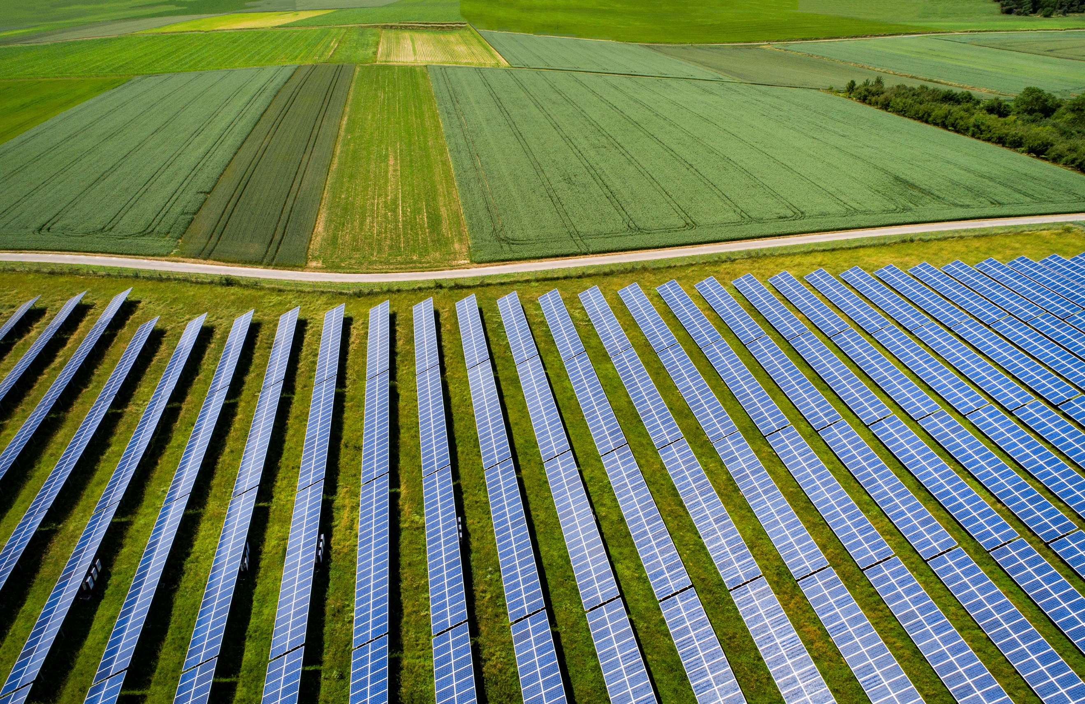

Draft document
May 11, 2024
The vision of Hon. Prime Minister
Net zero by 2070
50% Energy through Renewable sources by 2030
The Largest Distributed Solar Deployment Program (16GW)
Under PM-KUSUM
(Mukhyamantri Saur Krushi Vahini Yojana – 2.0)
Presentation by -
Lokesh Chandra (IAS)
Chairman & Managing Director, MSEDCL

Slide 2





Maharashtra is home to more than 1 Crore farmers,
who contribute to 30% of the state’s electricity consumption
1 Crore
Farmers
45 Lakh
Agri. Electricity Connections
12 %
Contribution GSDP
16,000 MW
Connected load
Maharashtra has the highest Agriculture demand in India (39,000 Mus)
Agriculture sector highly subsidized & the Major cause of Revenue losses to Discom

Slide 3





Mission 2026 for Solarisation of 30% Ag. Feeders and commissioning of 16,000 MW Solar Capacity
Reduction in cost of supply to agricultural and cross-subsidy burden on Industries
Investment of ~ Rs. 65,000 Crore across various districts in Maharashtra
Daytime Electricity supply to farmers and agriculture
Over 70,000 rural jobs and development of solar ecosystem and skills
Contribution to national and state solar targets, CO2 emission saving
3

Slide 4
5 Major Challenges addressed through Design Reengineering
Small Project Size
Land Availability
Delay in Permissions / NoCs
No Data Availability to Developers
Delay in Payments to SPDs
Cluster based approach
(200-250 MW - 50 MW)
Economics of Scale for Solar Power Developer
Identification of Govt. land within 5-10 km radius from of 33/11 KV Sub-Station.
40,000 Acres Govt. Land identified in 3 months.
Advance Clearance
Advance Grid Connectivity
More than 6,000 NoCs and Grid Connectivity Permissions issued.
Data Room With GIS Layered details of each land parcel
Geo Tagged Substations & land parcel details
Creation of revolving fund mechanism
Provision for Deemed Generation
Nodal Agency to extend payment security
Provision of Rs.100 Cr / 1000MW from Green Cess Fund
Extensive use of
PM GATI SHAKTI & other IT Portals.

Slide 5
Reengineering of Processes in 4 Major Steps
New Transactional Structure
Ease of Doing Business
Tagging of Projects with PM – KUSUM C
Formation of Maha Agro Solar Company
22 SPVs Created
Exclusive single window portal & access to data room to SPDs
From award of work to real time monitoring of Generation through SCADA will be from single window portal.
In order to avail 30% CFA (Central Finance Assistance)
Rs. 3500 Cr CFA approved, Rs. 3800 Cr in Process
State Incentives
Land Lease rent fixed @ Rs. 125000/ Hectare with 3% increase per year (For Private Land)
Social Development Grant to Gram Panchayat @Rs.5Lakh per year for 3 years
System Strengthening Grant @ Rs. 25 Lakhs per Substation (One Time)
Production Incentive for early commissioning @ 25 Paisa/ Unit at 11 KV and @ 15 paisa per unit at 33 KV (for 3 years )

Slide 6
16,000 MW Solar Capacity awarded in 10 months and work started
Transparent e-bidding process.
Cater to 100% of agriculture demand across 27 districts in the state
100% Capacity i.e. 16,000 MW has been awarded, 2921 sub-stations, 40 lakh pumps
Avg. tariff discovered Rs.3.06/kWh
All regulatory approvals in place alongwith tariff adoption.
Capacity commissioned 1,625MW, Sub-stations 309, feeders 1034, 4.04 Lacs pumps
Balance capacity will be commissioned upto September 2026 in phased manner.
3
31,233 MW
Agri. Solarization 16,000 MW
Solar project capacity (MW)
3,600 MW
500 MW
(MSKVY 1.0)
Prior to 2023-24
2025-26
Solar energy capacity of Maharashtra will be >8 times of the present solar capacity in next 15 months

Slide 7
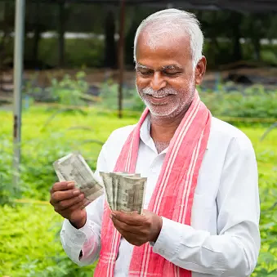

PM-KUSUM C / MSKVY 2.0 : Game Changer for all stakeholders
Reliable power supply
at desired voltage level
Day time supply of electricity
Additional income
1.25L per Ha per annum
from leasing of non-fertile land
Increased Participation of women workforce
Due to day-time availability of power
Lower electricity tariff
>20 Lakhs women benefitted
Before
After

Slide 8
PM-KUSUM C / MSKVY 2.0 : Game Changer for all stakeholders
Reduction in AT&C losses
Savings of Rs.10,000 Cr. In
Power Purchase Cost
20-25 %
22000 Cr
6-10 %
Before
After
Before
After
Reduction in annual Govt. subsidy to the tune of Rs.4500 Cr.
25% reduction in Green House Gas emissions (MtCO2e)
Before
After
Before
After
Cross-subsidy reduction on account of Rs. 1-1.5/kWh tariff reduction for commercial and Industrial consumers

Slide 9
Impact on Tariff : First time in the history of MSEDCL Average cost of supply is going down
MSKVY 2.0 and high RE integration in total power purchase reduces total power purchase cost.
In case of BAU, ACoS increases by CAGR of 9.19 % while actual CAGR is -1.94%
This also includes recovery of past period gap of Rs 33,689 Cr as tariff increase was not allowed in FY 2023-24
Overall saving due to RE power is Rs 66,000 Cr in next 5 years

Slide 10
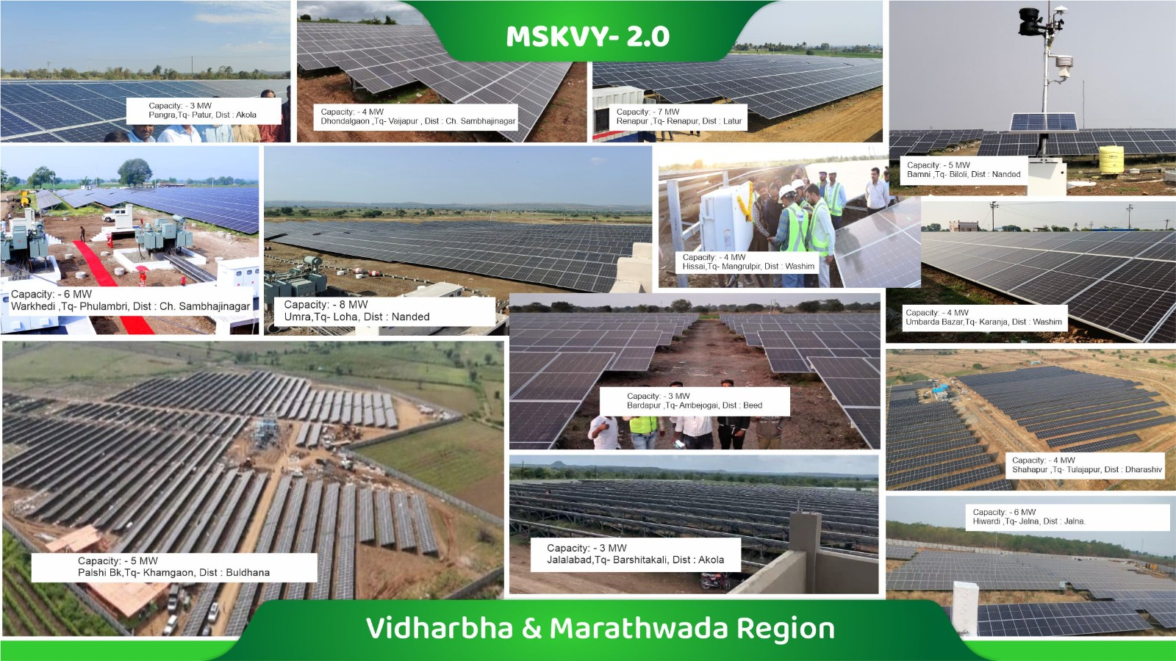
Several Projects commissioned in record time

Slide 11
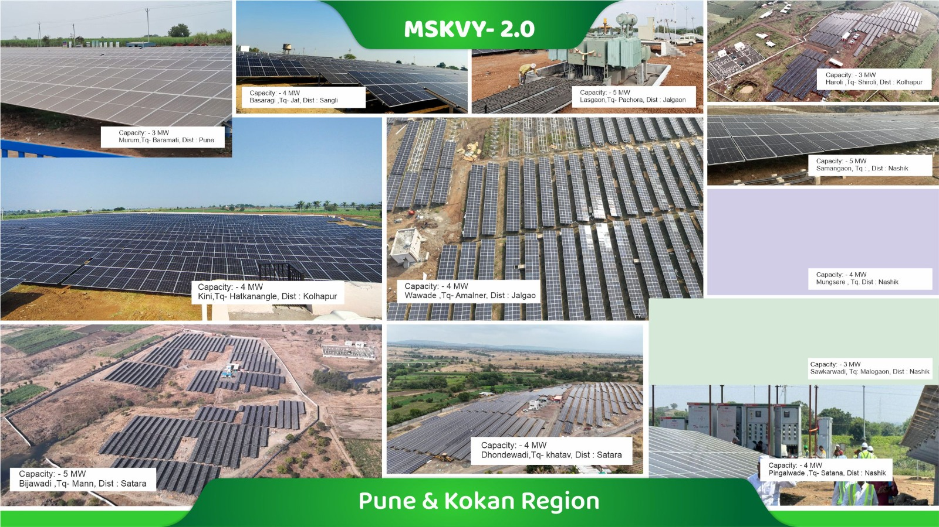
Several Projects commissioned in record time

Slide 12

Draft document
May 11, 2024
Thank You

Slide 13
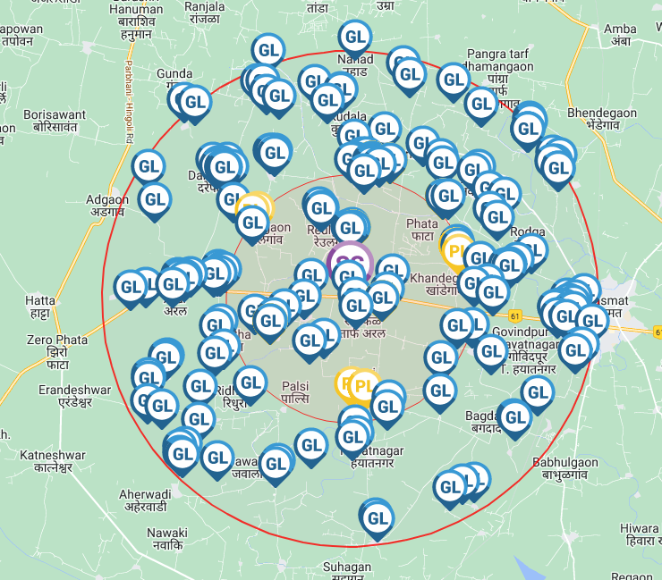
View on Map – Govt & Private Lands
Govt. lands within 10 km radius from substation
Government Land
Private Land
Private & Govt. lands within 5 km radius from substation

Slide 14
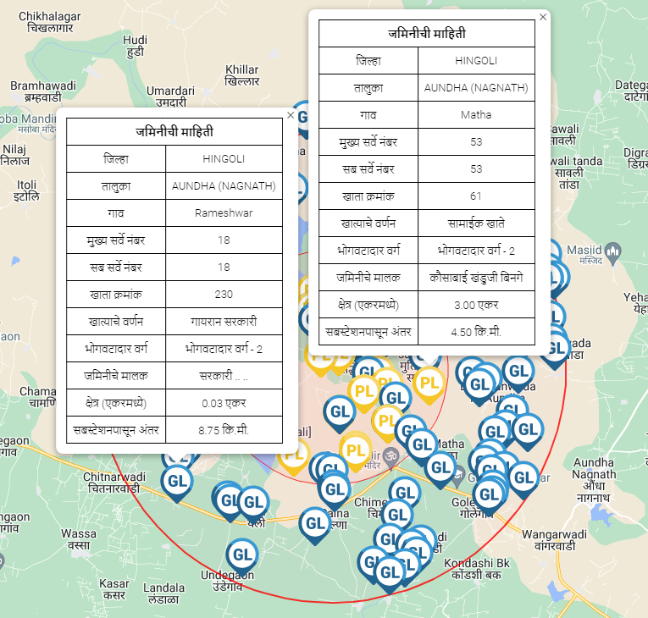
View on Map – Govt & Private Lands
Govt Land details
Private Land details

Slide 15
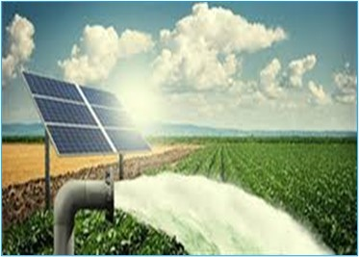
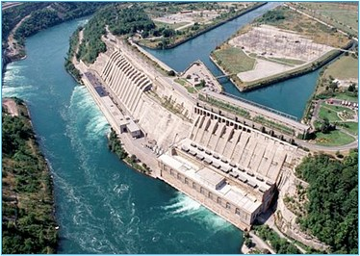
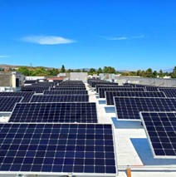
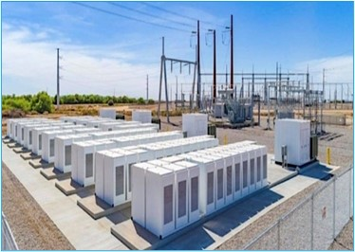
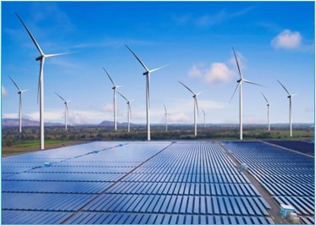
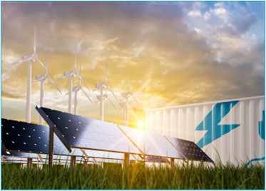

Capacity addition is planned meticulously considering Cost Optimization (From 36 GW to 81 GW)
16.60 GW of distributed Agri-solar (MSKVY 2.0) at average tariff Rs. 3.07/kWh
28 GWh of PSP storage at average tariff Rs. 3.2/kWh
11.45 GW of utility-scale solar at average tariff Rs. 2.7/kWh
Solar (5 GW) + Thermal (1.6 GW) at average tariff Rs. 4.08/kwh
1.5 GWh of battery storage at average tariff of Rs. 2.19 Lakh/month/MW
4.3 GW of solar-wind hybrid at average tariff Rs. 3.6/kWh
1.5 GW of round-the-clock FDRE at average tariff Rs. 4.6/kWh
Renewable Energy procurement share in installed capacity (MW) increases from 29% to 61% and in terms of energy (MUs) from 13% to 49%.

Slide 16
Maharashtra has pioneered the largest distributed solar deployment in India with huge success of PM KUSUM C
(Mukhyamantri Saur Krushi Vahini Yojana 2.0)
District Wise LoA’s issued (MW)
16,000 MW of agri-solar capacity will cater to 100% of Maharashtra’s agriculture load

Slide 17
Maharashtra has pioneered the largest distributed solar deployment in India with huge success of PM KUSUM C
(Mukhyamantri Saur Krushi Vahini Yojana 2.0)
District Wise Installed Capacity (MW)
1625 MW of agri-solar capacity installed till date

