Slide 1
Strengthening Load Research and Demand Forecasting capabilities of Discoms
Details of stagged approach for load forecasting
Prayas (Energy Group) – All India Discoms Association (AIDA)
June 2026

Slide 2
Background
Prayas(Energy Group), or PEG, in collaboration with AIDA found it important to have guidelines for strengthening load research and medium to long term demand and load forecasting capabilities in DISCOMs.
This study aimed to develop guidelines, undertake stakeholder consultations, and pilot implementation with select DISCOMs

Slide 3
Why load research and forecasting is essential for discoms?
Increasing variability and uncertainty in demand
  Uptake of EVs, air-conditioning, rooftop solar, and data centers is changing demand patterns
Need for granular and dependable planning
  Planning for power procurement, network upgrades, and resource adequacy now requires feeder/substation-level insights, not just annual peak forecasts.
Financial and operational impacts
  load shedding, high-cost short-term purchases, penalties, excess PPAs, non performing investments, high-cost market purchase
High RE and DERs
  High rooftop solar and behind-the-meter DERs require diurnal profiles, weather-linked models, and probabilistic forecasts

Slide 4
Current Demand and Load Forecasting Practices
Current Load forecasting (LF) and Resource Adequacy (RA) guidelines recommend use of relatively simple (aggregate ,trend-based methods ) for demand and load forecasting while recognizing the value of more granular, richer forecasting.
Demand and load Forecasting is typically based on historical peak demand and energy sales (at the DISCOM level).
Load Forecasts are mostly limited to Annual Peak (MW), Annual Energy Requirement (MU), and Seasonal/Monthly Peaks.
Lack of systematic approach to measure uncertainty or variability in demand under in such approaches.
Demand and load forecasting practices will need to evolve towards greater granularity and probabilistic methods to enable more robust planning.
This will require integration of top-down and bottom-up models, leverage diverse data sets (e.g., AMI, end-use surveys, feeder/DT level data), and apply advanced algorithms for improved forecasting accuracy.

Slide 5
Limitations of Using Only Peak Demand and Energy for forecasting
Peak demand captures only single point estimate; does not reflect time or duration of peak
Annual Energy Demand ; Masks intra-day and seasonal variations
Does not provide data for:
  Coincident peak assessment
  Network loading /planning
  Extreme weather or heat-wave demand analysis
  Seasonal / peak vs base load for better power procurement

Slide 6
Proposed stage-wise approach
Aggregate load curve based estimation
Circle/feeder level data based estimation
Estimation to account for changing end-uses, temperature etc.

Slide 7
Why stagged approach for load research and forecasting
DISCOMs highlighted current load forecasting
  Advance AI/ML tools + Weather data integrated for Short Term ( Day ahead – Week Ahead) Forecasting
  Long Term forecasting ( 5-10 years) typically based on CAGR
Aggregate DISCOM load curve can provide seasonal trends, peak load and duration and variation across time period
Load varies across divisions, feeders and consumer categories
Contribution of cooling loads, EVs and commercial demand to overall peak is not known
Smart meter and feeder data available but may be uneven
Independent but complementary Stages of Load Forecasting can be adopted depending upon data availability

Slide 8
Aggregate Load Curves for Load Forecasting
Aggregate Load Curve (15-Minute Resolution)
Captures time-wise and seasonal variation of electricity demand across the system
Forms the base demand curve for long-term demand assessment as per CEA planning practice
Preserves load shape, coincidence, ramping, and seasonal variation

Slide 9
Using Circle/Feeder level data to improve forecasting
CEA – Perspective Plan already recommends granular ( spatial) planning
Circle/Feeder Level data can provide information on :
  Demand variations across Circles, Divisions , Feeders
  Urban Vs. Rural load patterns
  Residential, Commercial , Industrial load patterns
  Localized Peaks
Approach will focus on representative feeder load curves
Data /Insights on demand drivers
This approach will also help in better network planning, better demand / load estimation due to finer data (e.g. faster growth in some circles vs others)

Slide 10
Using AMI Smart Meter & Load Research Data for Improved Load Forecasting
Circle/Feeder level data does not fully explain why and how demand evolves
Emerging loads (cooling, EVs, commercial activity) are consumer-behavior driven
AMI data can capture actual consumer behavior, not averaged over feeder
  Representative consumer load shapes
Targeted Surveys as part of Load research can provide :
  Appliance penetration and growth
  Usage intensity

Slide 11
Detailed Framework for the Stagged Approach
Parameters | Stage 1: Utility-Level | Stage 2: Feeder-Level | Stage 3: Consumer-Level
Objective | Forecast system-level load & peak demand | Use spatial, consumer mix& diversity load | Derive behavior & technology-driven demand
Data Sources | SLDC system load (15-min), energy sales IMD Weather Data | SCADA / feeder meters, substation data Socio Economic Data | AMI smart meters, load research through surveys, appliance data, Weather Data
Temporal Resolution | 15-minute blocks | 15-minute blocks | 15 / 30-minute
Forecast Horizon | 3–5 years, 10 years | 3-5 years | 1-3 years
Key Outputs | System load curves, peak demand and demand patterns | Division & feeder level load curves | Consumer load shapes, DSM potential
Primary Use | Capacity & procurement planning | Network & capex planning | DSM, ToU, flexibility planning

Slide 12
Forecasting Methods & Limitations
Parameters | Stage 1: Utility-Level | Stage 2: Feeder-Level | Stage 3: Consumer-Level
Methods for forecasting Basic Detailed Advanced | CAGR, trend analysis Seasonal (STL) decomposition, SARIMA/SARIMAX Demand Prediction Models ( AI), quantile regression, probabilistic (Monte Carlo Simulations) | Scaled CAGR on representative feeders Feeder clustering, coincident peak analysis Hierarchical & spatio-temporal models Monte Carlo Simulations (If data) | Average load shape scaling Load shape clustering, bottom-up models AI/ML, LSTM, scenario analysis
Strengths | Faster, regulator-aligned, low data requirement | Improves spatial accuracy | Captures demand behavior & trends
Limitations | Limited spatial granularity | Limited consumer level insight | High data granularity & processing requirements
Important Inputs | Weather Data | SCADA Coverage | AMI Data
Notes:
Feeder demand growth distributions
Variability in load shapes

Slide 13
Value of the approach
More realistic peak demand projections
Better alignment with RDSS and smart metering investments
Targeted network strengthening and DSM programs
Data Collection for Long‑term flexibility and Specific (cooling, EV) demand planning

Slide 14
Thank You

Slide 15
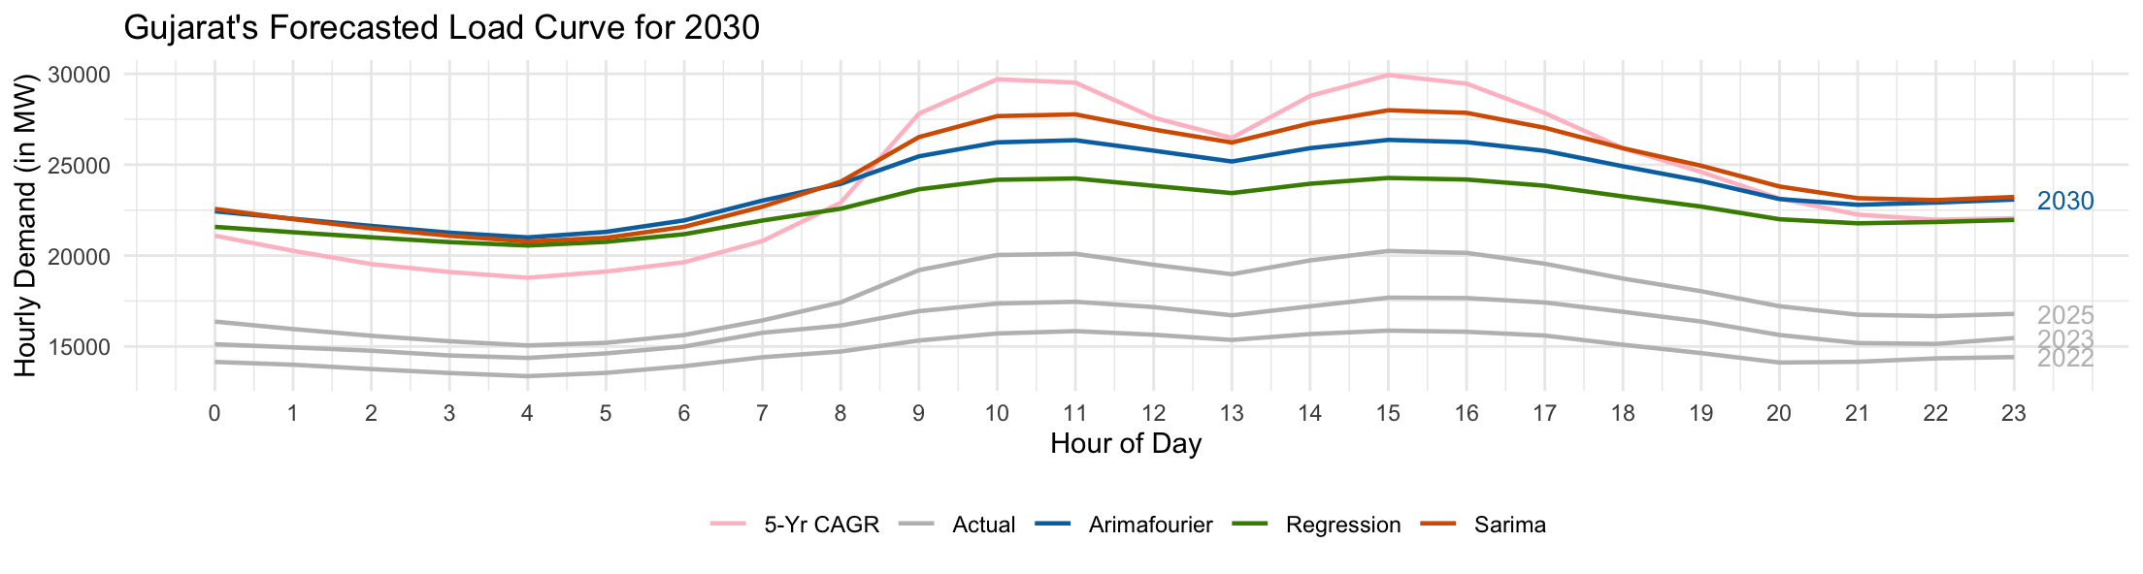
Forecasted Load Curve
It is essential to capture seasonality as well as change in demand.
Each method provides a forecasted a value for both, can be treated as scenarios.

Slide 16
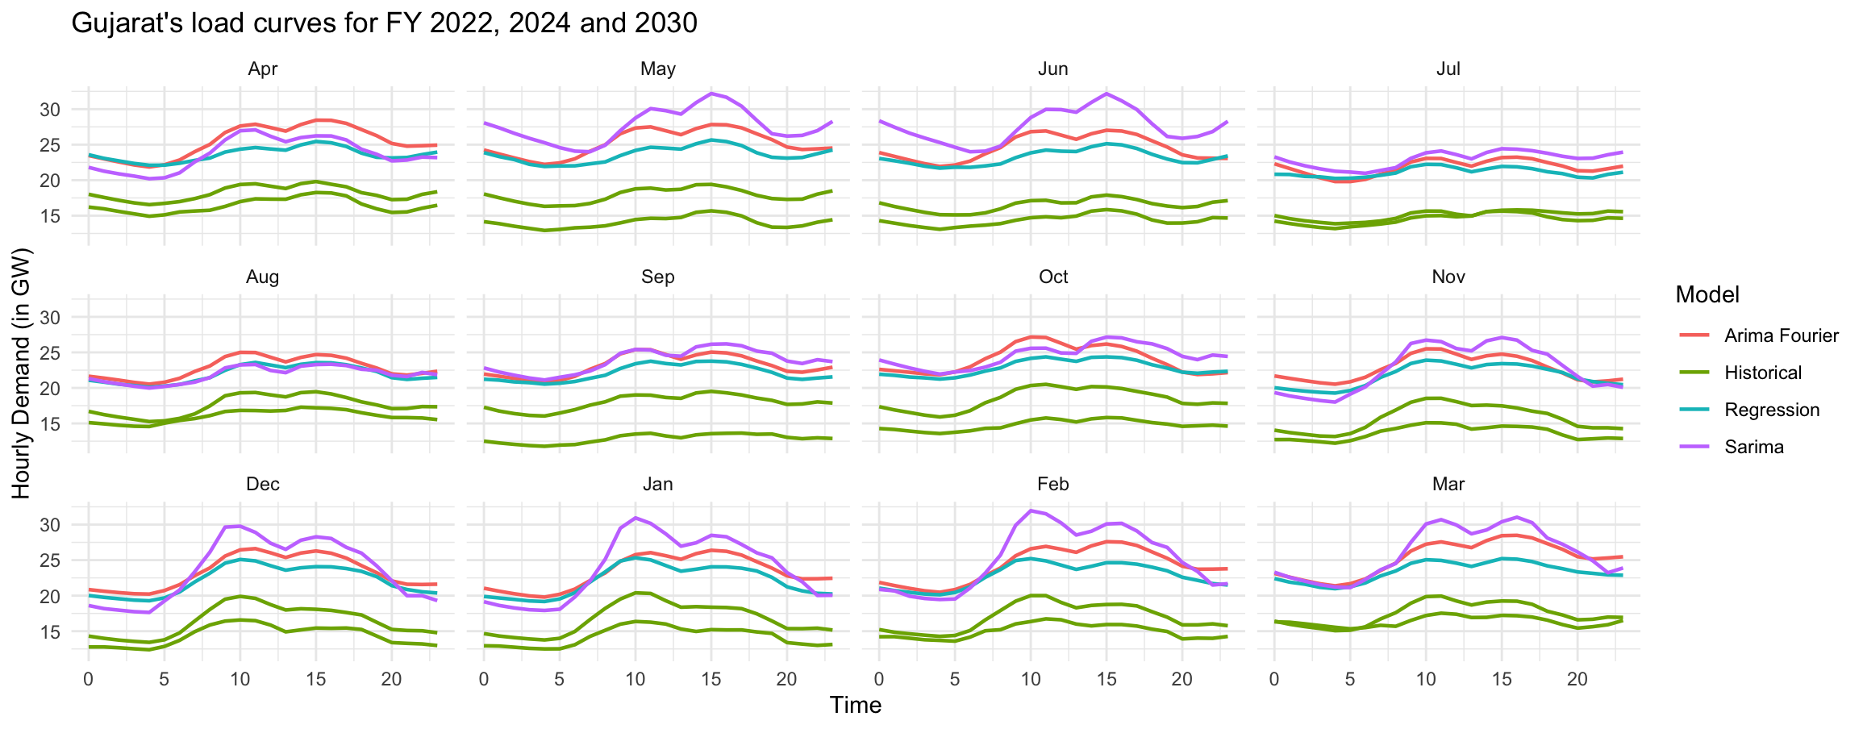
Forecasted Monthly Load Curve

Slide 17
Forecasted Energy Requirement
Methodology | Annual Energy Demand (MU) for FY2030 | Peak Demand (MW) | Month and Time
20th Electric Power Survey | 226141 | 33964 | -
Gujarat Resource Adequacy Plan | 178700 | 33250 | -
Alternative Projections
Arima Fourier | 208623 | 28490 | March 16th
Regression | 197375 | 25660 | May 15th
Sarima | 214122 | 32198 | May 15th

Slide 18
Questions for Breakout Discussion
What data sources are currently available for demand forecasting, and what are the main gaps in data quality, granularity, or access?
Where (locations , sectors) are you observing the most significant changes in load growth or load shape, and what are the main drivers behind these changes?
How can current forecast methods be improved? What organizational capacity or skills are needed for it?
If you could implement one forecasting improvement over the next two years, what would it be and why?

