Slide 1



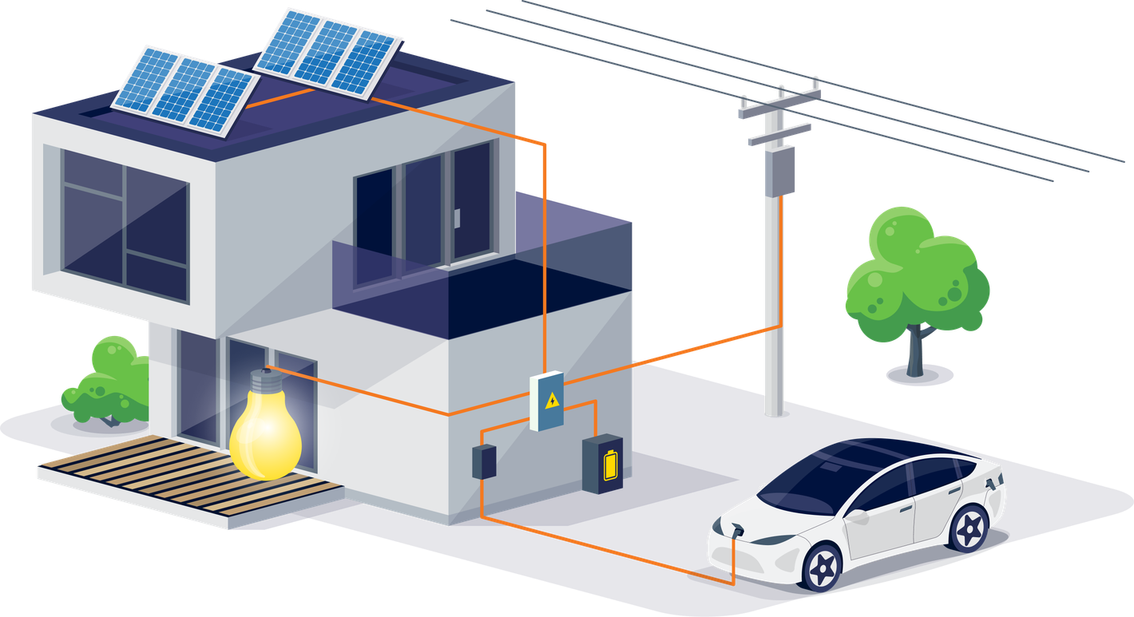
Peer-to-Peer Solar Energy Transactions Platform on Blockchain
Empowering People's Energy Choices
Presented by:
UPPCL
www.uppcl.org

Slide 2

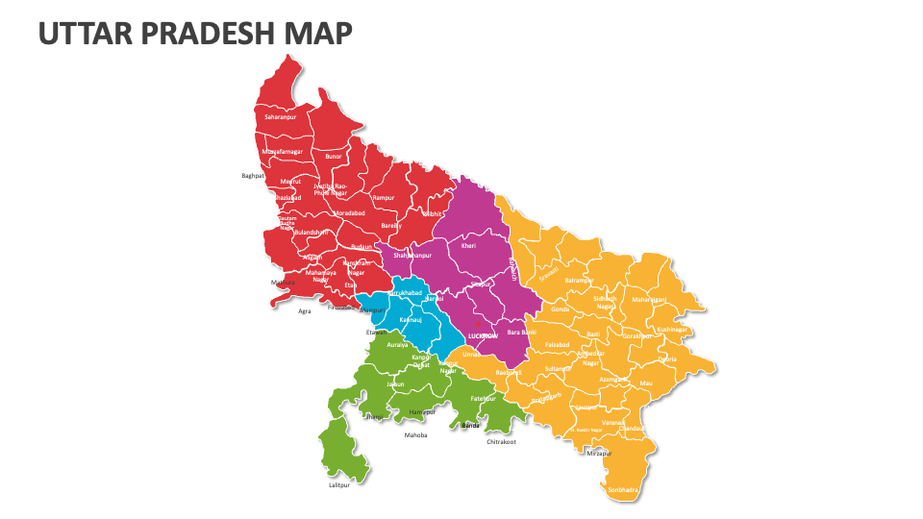
UPPCL AT GLANCE
More than 80% of UPPCL's consumer base comprises residential consumers, creating one of the world's largest potential prosumer and P2P energy trading markets.
Total 3 crore smart meters targeted under RDSS Smart meter program, positioing as one of the India,s largest smart meter program.
Total solar rooftop application received approx 12 Lakhs and solar rooftop installed 4.5 Lakhs and target is 8+ Lakhs (till May 2027)
Serving India's most populous state through 5 Distribution Utilities MVVNL, PVVNL, PuVVNL, DVVNL, KESCO.
Total electricity consumers in UPPCL are 3.4 Crores and out of which approx 2.8 Crores are domestic consumers (83.10 %), approx 30 Lakhs are commercial (8.02%), approx 4 Lakhs are Industrial consumers (1.06 %), other categories are approx 26 Lakhs (7.82%).
Connected load is approx 120+ GW Sanctioned Load Base (all consumer categories combined)
Among the first states in India to establish a regulatory framework & to start P2P energy trading for consumers.
Notes:
The energy landscape in India in undergoing a significant transformation, driven by ambitious renewable energy targets, technological advancements, and evolving consumer expectations. In this context, Peer-to-Peer (P2P) solar energy trading has emerged as a groundbreaking model that can revolutionize the way electricity is generated, consumed, and distributed. This innovative system enables individuals and businesses with rooftop solar installations to sell their excess electricity directly to other consumers, fostering a decentralized and democratized energy market.
In the Indian context, where the adoption of renewable energy is rapidly increasing, P2P solar energy trading offers a significant opportunity for Distribution Companies (DISCOMs) to modernize their operations, improve grid efficiency, and support the transition to a decentralized, green energy ecosystem.

Slide 3
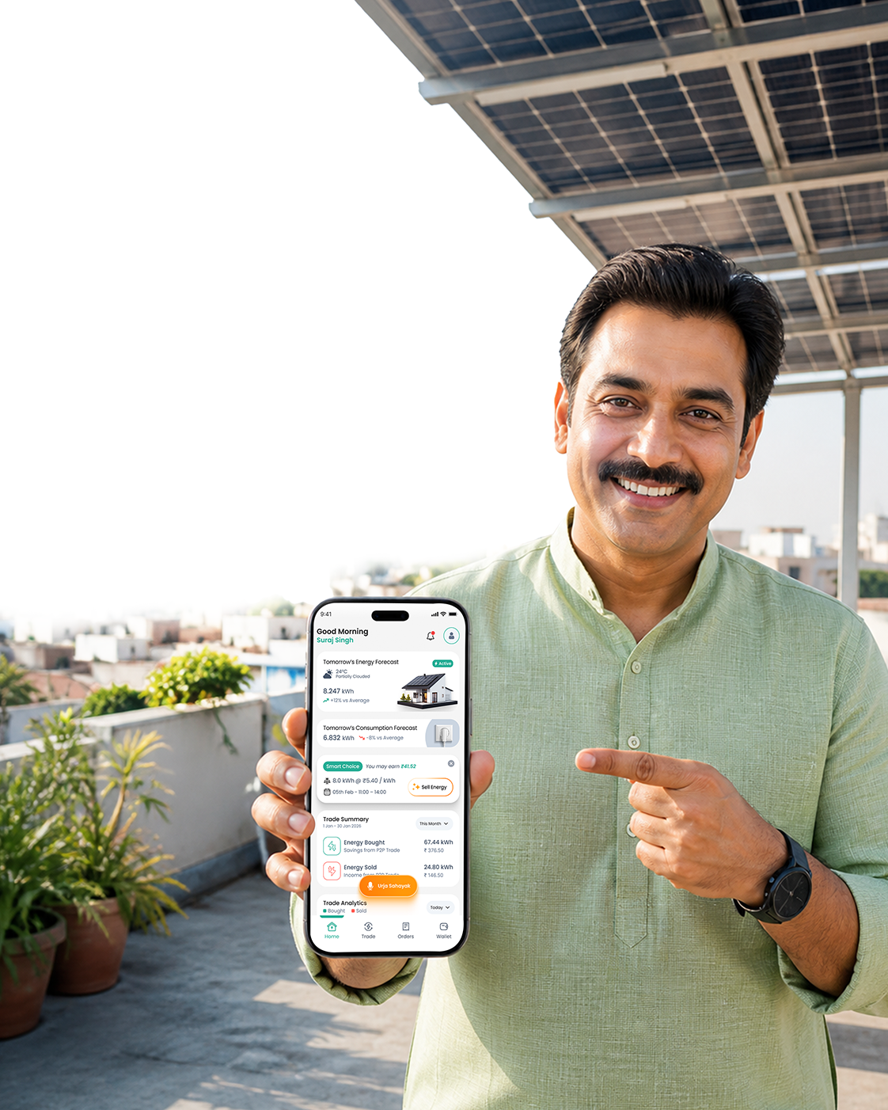
INTRODUCTION TO P2P SOLAR ENERGY TRANSACTIONS
From Net Metering to Energy Transactions – Empowering Consumers as Active Market Participants.
Peer-to-Peer (P2P) Energy Transactions enables consumers and prosumers to buy and sell surplus solar energy through a blockchain-based secure digital marketplace.
Promotes local energy exchange, maximizing rooftop solar utilization and reducing dependence on conventional power sources during daytime.
Supports consumer empowerment by providing greater choices, competitive pricing, and transparent transactions.
Helps DISCOMs improve grid efficiency, reduce peak demand, and increase renewable energy integration.
Leverages smart meters, AI-based forecasting, and automated settlement for seamless and reliable operations.
Aligns with India's vision of decentralized, digital, and sustainable electricity markets.
Notes:
The energy landscape in India in undergoing a significant transformation, driven by ambitious renewable energy targets, technological advancements, and evolving consumer expectations. In this context, Peer-to-Peer (P2P) solar energy trading has emerged as a groundbreaking model that can revolutionize the way electricity is generated, consumed, and distributed. This innovative system enables individuals and businesses with rooftop solar installations to sell their excess electricity directly to other consumers, fostering a decentralized and democratized energy market.
In the Indian context, where the adoption of renewable energy is rapidly increasing, P2P solar energy trading offers a significant opportunity for Distribution Companies (DISCOMs) to modernize their operations, improve grid efficiency, and support the transition to a decentralized, green energy ecosystem.

Slide 4
KEY HIGHLIGHTS OF UPERC GUIDELINES
Regulatory Framework for P2P Trading
UPERC has established India's first comprehensive guidelines enabling blockchain-based Peer-to-Peer solar energy trading.
Consumer-Centric Energy Marketplace
Enables rooftop solar prosumers to directly sell surplus energy to registered consumers through a digital P2P platform.
Smart Meter & MDM Integration
Participation is enabled through smart meters with meter data sourced from the DISCOM's Meter Data Management (MDM) system for accurate settlement.
Market-Driven Pricing
Buyers and sellers mutually determine the transaction price, creating a transparent and competitive energy marketplace.
DISCOM-Led Billing & Settlement
Energy billing, wheeling charges, and P2P settlements remain integrated with the DISCOM billing ecosystem.
Protection of DISCOM Revenue
Wheeling charges and applicable open access charges continue to accrue to the Distribution Licensee, ensuring financial sustainability.
Renewable Purchase Obligation (RPO) Benefits Retained
Renewable energy benefits from rooftop solar continue to remain with the DISCOM.

Slide 5
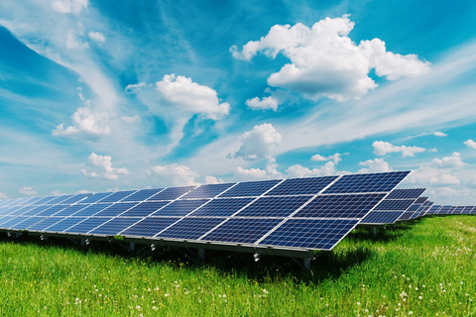


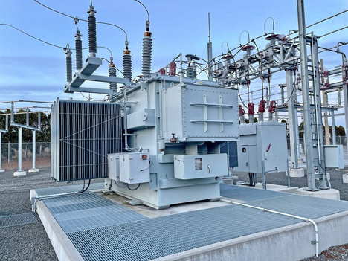
WHY PEER-TO-PEER (P2P) SOLAR ENERGY TRANSACTION MATTERS
RISING SOLAR ADOPTION IN INDIA
With India targeting 500 GW of renewable energy capacity by 2030, rooftop solar systems have created a growing base of prosumers. P2P trading enables them to monetize surplus energy effectively, providing better returns than current grid feed-in mechanisms.
TECHNOLOGICAL ADVANCEMENTS & INNOVATIONS
Innovations like blockchain, smart meters, and digital platforms allow secure, transparent, and automated energy transactions. These technologies ensure real-time monitoring, tamper-proof records, and seamless payments.
MAXIMIZING DISTRIBUTED ENERGY VALUE
P2P trading unlocks the full value of rooftop solar by enabling local energy exchange, improving asset utilization, and creating benefits for consumers, prosumers, and utilities alike.
EMPOWERING FUTURE-READY UTILITIES
P2P energy trading enables DISCOMs to evolve into digital energy market facilitators while improving operational efficiency, consumer engagement, and renewable energy integration.
Notes:
The energy landscape in India in undergoing a significant transformation, driven by ambitious renewable energy targets, technological advancements, and evolving consumer expectations. In this context, Peer-to-Peer (P2P) solar energy trading has emerged as a groundbreaking model that can revolutionize the way electricity is generated, consumed, and distributed. This innovative system enables individuals and businesses with rooftop solar installations to sell their excess electricity directly to other consumers, fostering a decentralized and democratized energy market.
In the Indian context, where the adoption of renewable energy is rapidly increasing, P2P solar energy trading offers a significant opportunity for Distribution Companies (DISCOMs) to modernize their operations, improve grid efficiency, and support the transition to a decentralized, green energy ecosystem.

Slide 6
UTTAR PRADESH: INDIA'S EMERGING LEADER IN PEER-TO-PEER ENERGY TRADING INITIATIVE
Large rooftop solar base
  4.5+ lakh rooftop solar installations & around 2 GW rooftop solar capacity.
  Among India's fastest-growing rooftop solar markets
Unmatched Consumer Scale
  3+ crore electricity consumers.
  Potential to create one of the world's largest local energy marketplaces
Progressive Regulatory Ecosystem
  Strong support from UPERC. UPERC issued the P2P energy transactions guidelines in 2023.
  Early adoption of consumer-centric energy market innovations
Smart Meter-Ready Infrastructure
  Large-scale smart meter deployment
  Enables meter data validation, settlement, and transparent billing
Utility-Led Innovation
  DISCOM-integrated P2P transaction model.
  Ensures scalability, compliance, grid reliability, and consumer trust
Strong Renewable Energy Policy Push
  Target of 8+ lakh rooftop solar installations by 2027 in the State.
  Accelerated adoption through PM Surya Ghar and UPNEDA initiatives
Notes:
The energy landscape in India in undergoing a significant transformation, driven by ambitious renewable energy targets, technological advancements, and evolving consumer expectations. In this context, Peer-to-Peer (P2P) solar energy trading has emerged as a groundbreaking model that can revolutionize the way electricity is generated, consumed, and distributed. This innovative system enables individuals and businesses with rooftop solar installations to sell their excess electricity directly to other consumers, fostering a decentralized and democratized energy market.
In the Indian context, where the adoption of renewable energy is rapidly increasing, P2P solar energy trading offers a significant opportunity for Distribution Companies (DISCOMs) to modernize their operations, improve grid efficiency, and support the transition to a decentralized, green energy ecosystem.

Slide 7















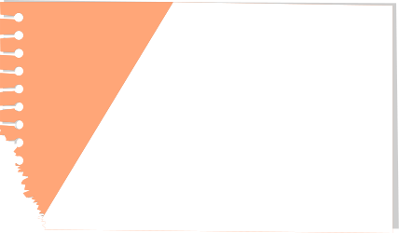

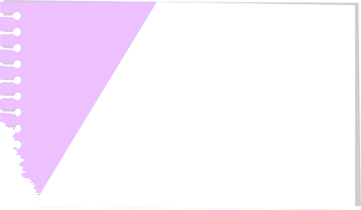

UPPCL’S P2P TRADING INITIATIVE’S JOURNEY
UP P2P Guidelines
Service Provider Selection
Interstate IES Pilot
UPERC was among the first regulators in India to issue P2P Energy Transaction Guidelines (April 2023), enabling the growth of decentralized energy markets..
UPPCL selected 4 Service providers for P2P energy i.e. PowerXchange, ISGF & Fluent grid,Orange current. Out of 4, currently PowerXchange actively implementing the P2P across all 5 discoms.
UPPCL discom PVVNL along with REC, ISGF, FIDE Powerxchange (Technology partner) & trade platforms executed the interstate pilot with Delhi utilities Tata Power & BSES.
April 2023
2025
2026
Origin
UPPCL P2P EOI
P2P UEI Pilot
Impact
Introduce the starting point of the story, project, or idea and explain how everything began.
UPPCL Issued EOI for selection of service provider for P2P solar energy transactions through blockchain based platform
ISGF and its partners (Powerxchange was one of the partner) executed the one of the first UEI based P2P energy trading pilot in Lucknow.
Summarize the results, influence, or lasting contribution of the work.
2017
Aug 2024
2025
2030

Slide 8
KEY LEARNINGS FROM UPPCL'S P2P JOURNEY
Successful implementation requires a balanced focus on regulation, technology, consumer engagement, and operational integration.
Regulatory Readiness
  A clear regulatory framework is the foundation for successful P2P implementation.
  Active utility participation builds stakeholder confidence and accelerates adoption.
Technology Enablement
  Smart meter integration is critical for accurate energy accounting and settlement.
  Automated transaction and settlement mechanisms are essential for scalability.
Consumer Awareness & Adoption
  Consumer awareness and education are as important as technology deployment.
  Simple, transparent, and user-friendly processes drive higher participation.
Operational Integration
  P2P trading can be integrated with existing utility systems and processes.
  Energy trading can coexist seamlessly with current billing and settlement mechanisms.
Scalability & Replicability
  A utility-led P2P model can be replicated across DISCOMs with existing smart metering infrastructure.
  Standardized processes enable faster adoption and large-scale deployment.
Data Security & Consumer Trust
  Consumer data privacy and cybersecurity must be embedded into the P2P ecosystem from the outset
  Secure data exchange, transparent transactions, and robust governance frameworks are essential for consumer confidence and regulatory compliance.
Notes:
The energy landscape in India in undergoing a significant transformation, driven by ambitious renewable energy targets, technological advancements, and evolving consumer expectations. In this context, Peer-to-Peer (P2P) solar energy trading has emerged as a groundbreaking model that can revolutionize the way electricity is generated, consumed, and distributed. This innovative system enables individuals and businesses with rooftop solar installations to sell their excess electricity directly to other consumers, fostering a decentralized and democratized energy market.
In the Indian context, where the adoption of renewable energy is rapidly increasing, P2P solar energy trading offers a significant opportunity for Distribution Companies (DISCOMs) to modernize their operations, improve grid efficiency, and support the transition to a decentralized, green energy ecosystem.

Slide 9
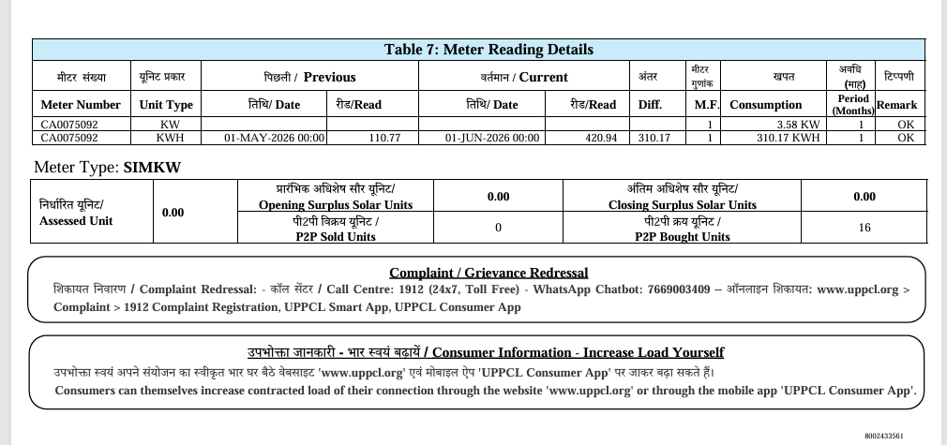
USER ELECTRICITY BILL WITH P2P UNITS ADJUSTED (JUNE MONTH BILL)

Slide 10
POWERING PARTICIPATION: CONSUMERS ONBOARDED (IN LAST 45 DAYS)
1217
Users onboarded till date
99
366
303
424
25
PVVNL
MVVNL
DVVNL
PUVVNL
KESCO

Slide 11
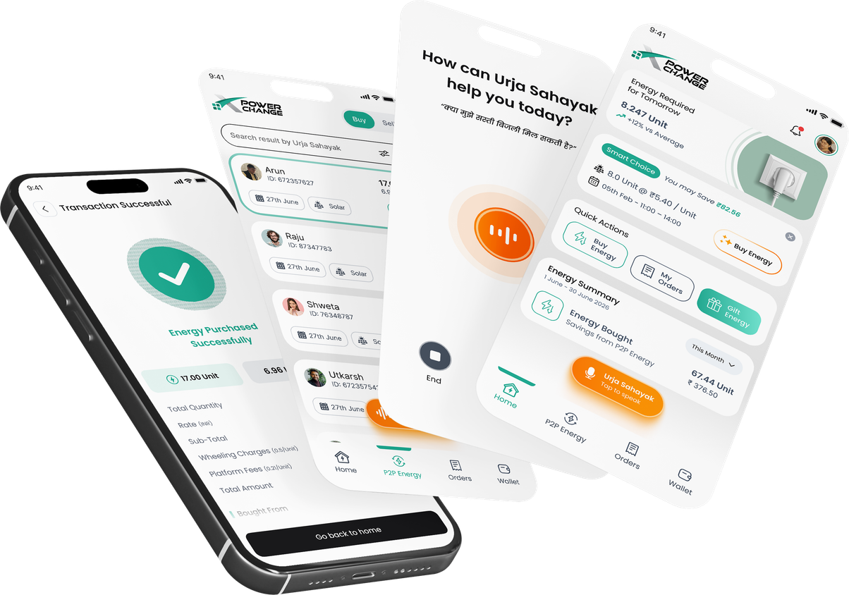
POWERXCHANGE
P2P PLATFORM
OVERVIEW

Slide 12
KEY FEATURES OF POWERXCHANGE PLATFORM:
Peer-to-Peer Energy Marketplace
Enables secure buying and selling of surplus rooftop solar energy.
Smart Meter & MDM Integration
Seamless integration with AMISPs and DISCOM Meter Data Management (MDM) systems.
Digital Wallet & Payment Gateway
Secure wallet management, online payments, and automated payouts.
Automated Billing & Settlement
Time-block-based settlement with integration to DISCOM billing systems.
UrjaSahyak Voice AI Assistant
Voice-based conversational AI assistant enabling consumers to buy, sell, and manage energy through natural voice interactions.
Secure & Blockchain-Enabled Transactions
Transparent, immutable, and tamper-proof energy transactions.
Energy Forecasting
Predicts solar generation and consumption using weather and historical data.
Inter-state Trading Enabled through IES
Supports both intra-DISCOM and inter-DISCOM P2P energy trading.

Slide 13
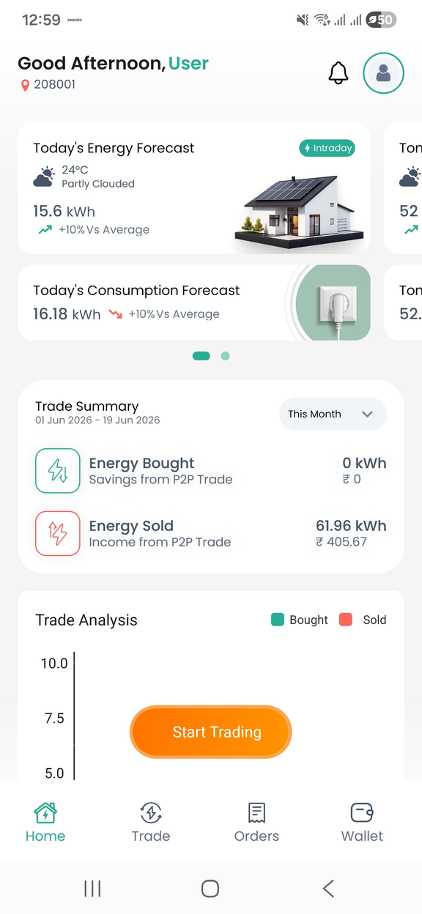
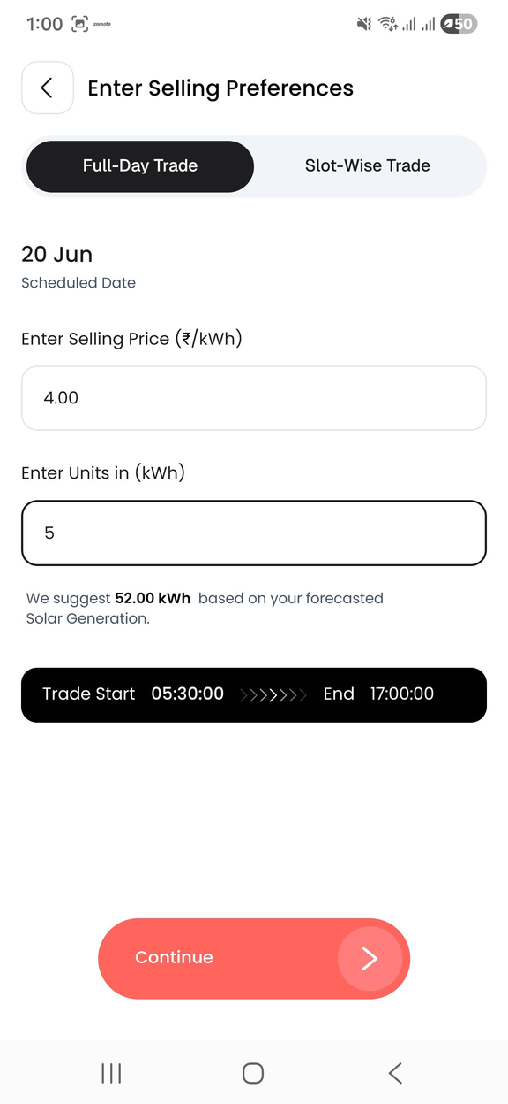
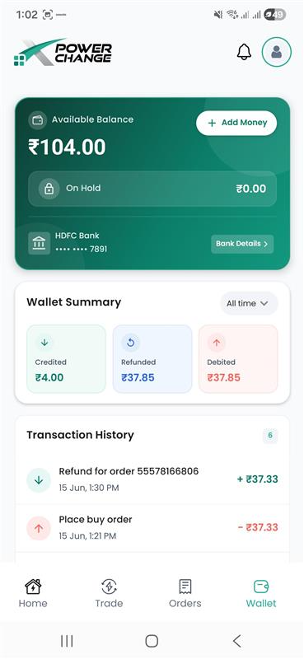
INTRASTATE - POWERX P2P (PROSUMER VIEW)

Slide 14
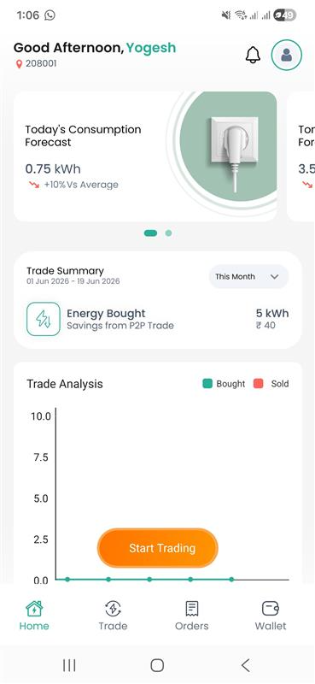
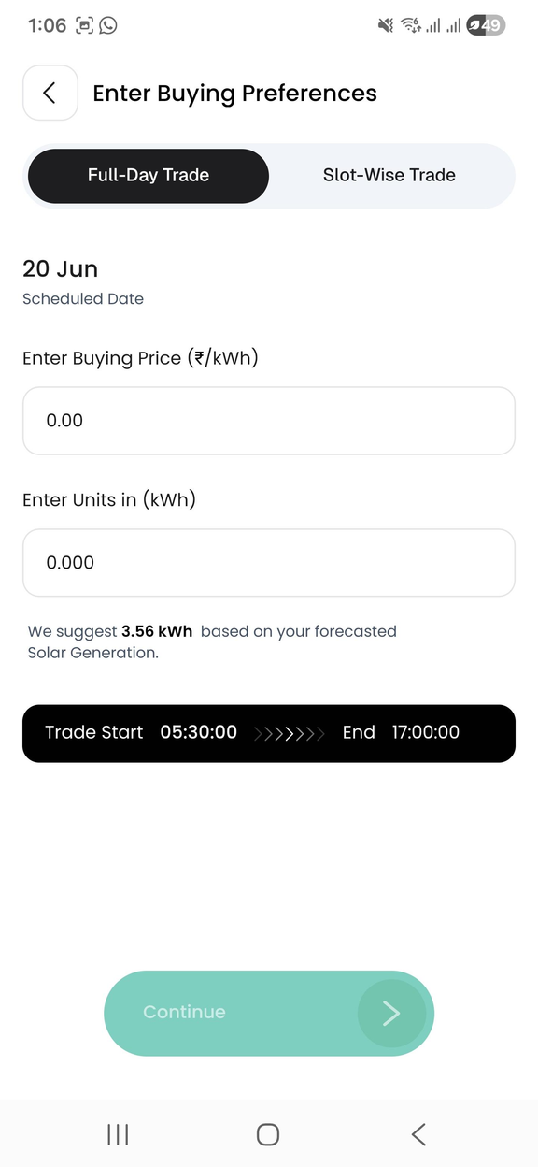
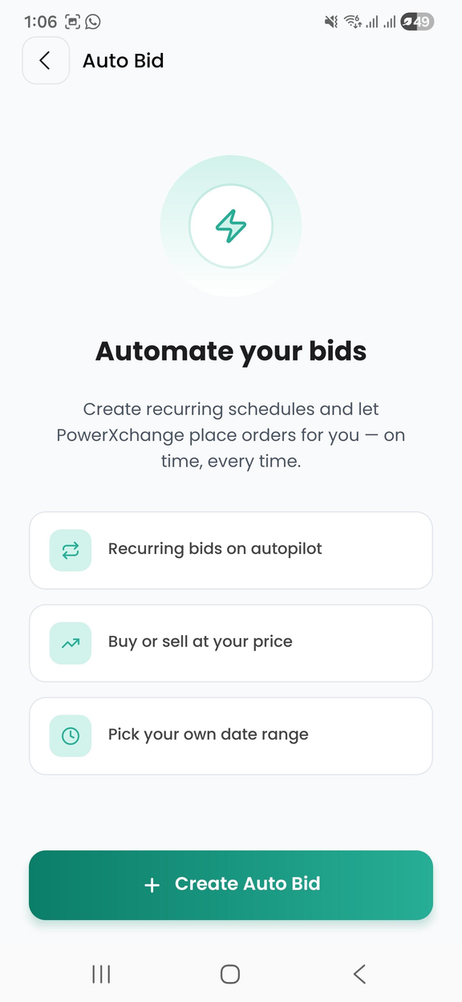
INTRA STATE - POWERX P2P (CONSUMER VIEW)

Slide 15
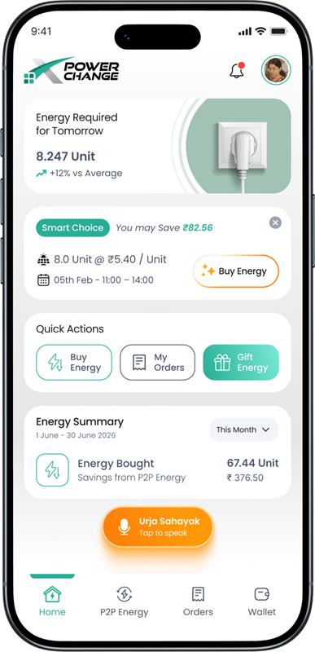
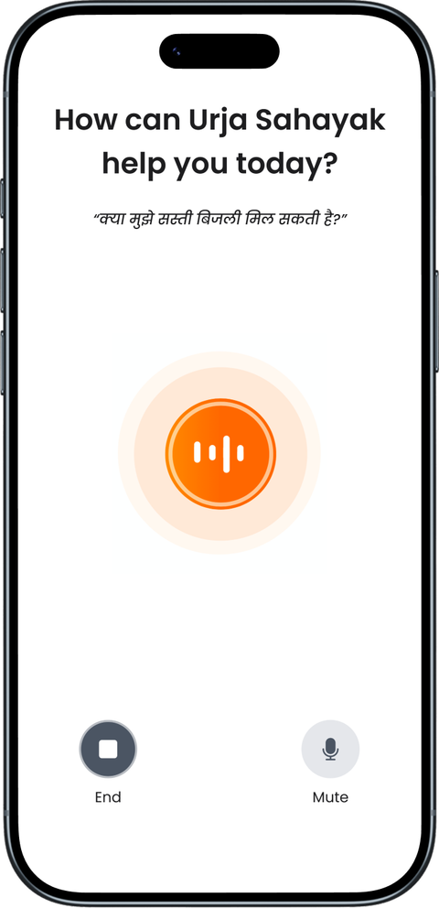
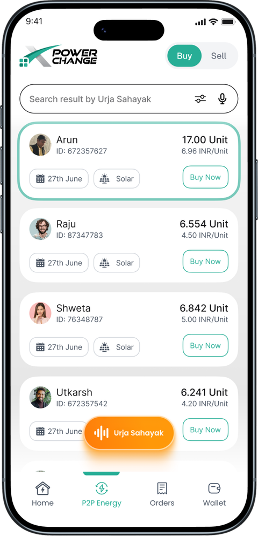
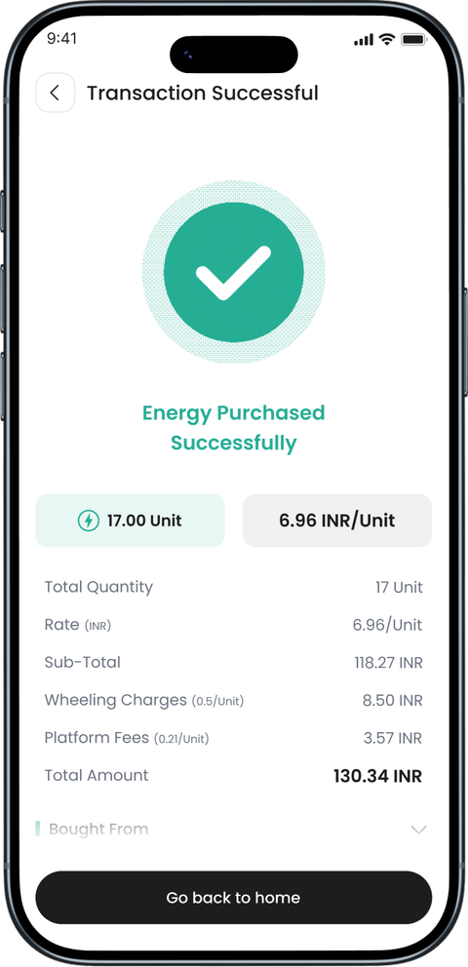
INTER STATE - POWERX TRADE

Slide 16
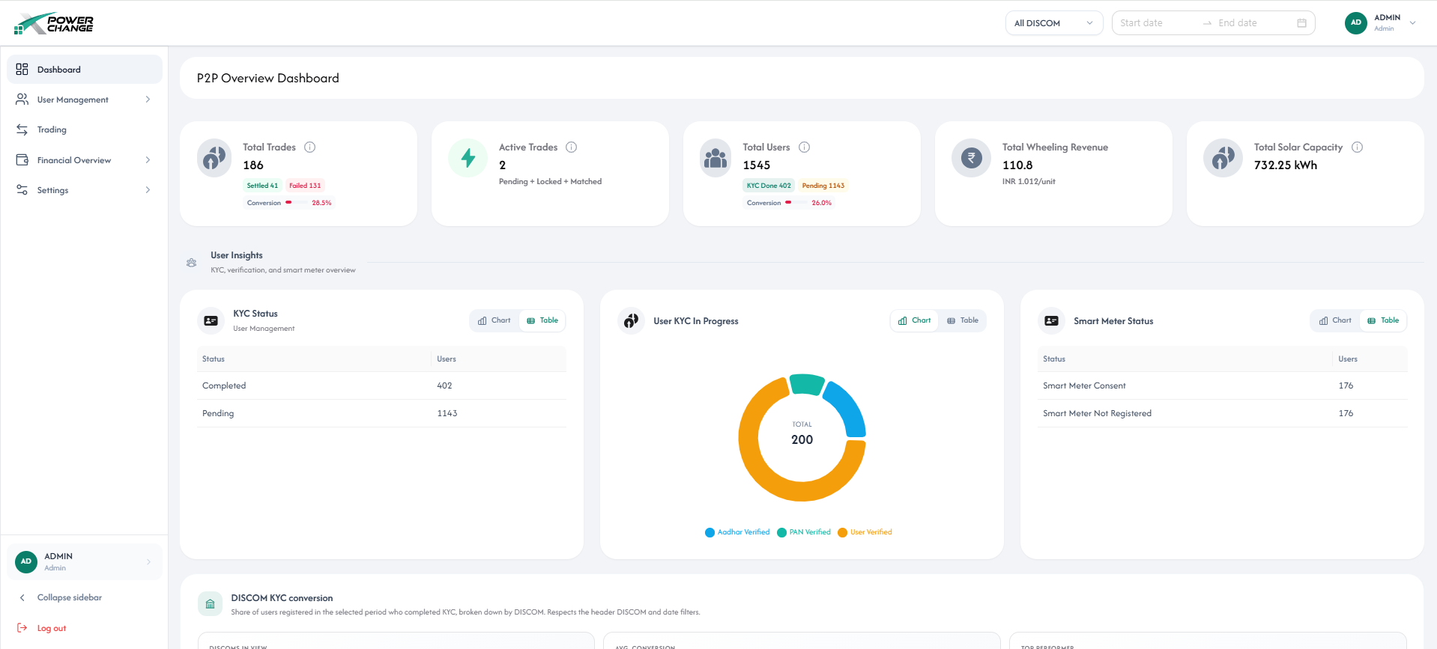
PLATFORM’S ADMIN PANEL

Slide 17
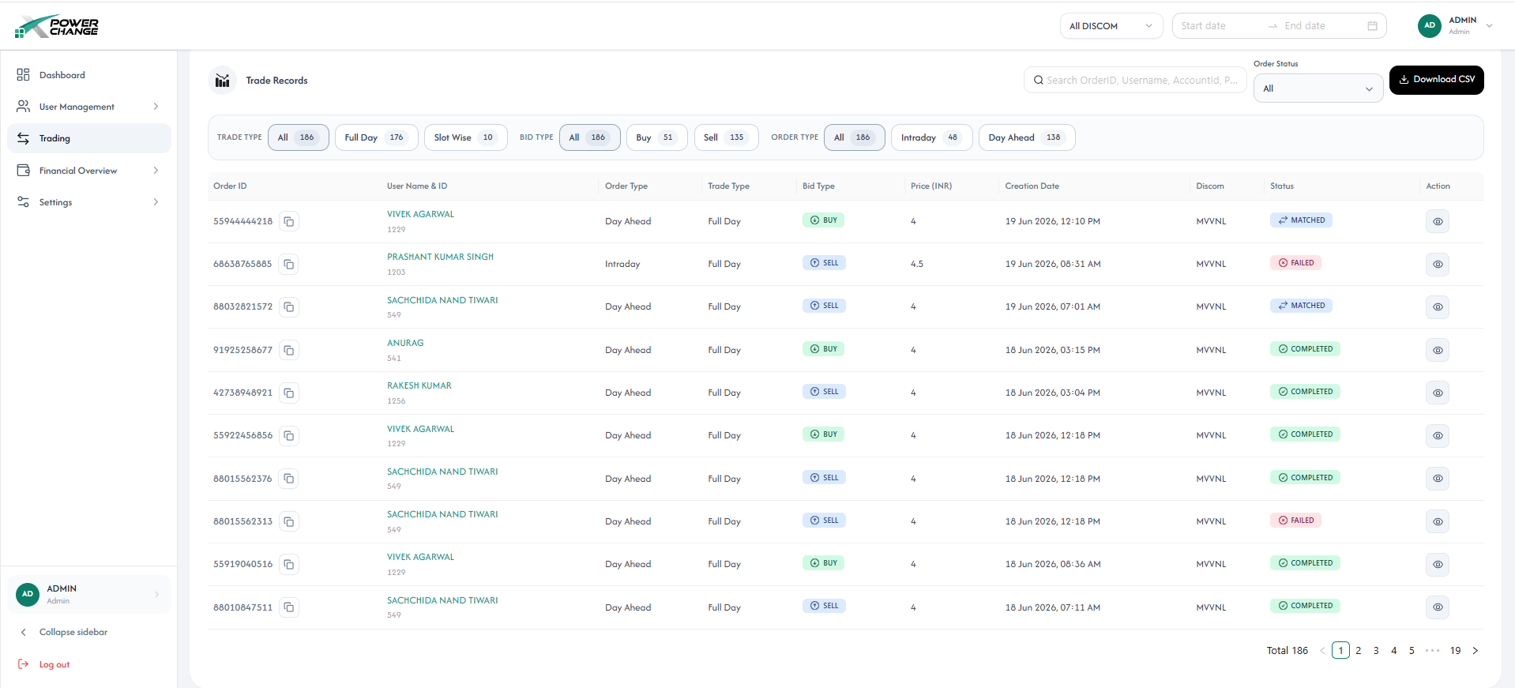
PLATFORM’S ADMIN PANEL

Slide 18
HOW POWERXCHANGE WORKS
PowerXchange is a peer-to-peer energy trading platform where prosumers sell surplus solar energy and consumers buy energy directly from the marketplace using wallet balance.
Step 1: Download & Login
Step 4: Dashboard Overview
  Download the PowerXchange app from Google Play Store.
  Enter your registered mobile number.
  Click Request OTP and verify the 4-digit OTP.
  After OTP verification, you are logged in successfully.
  Generation Energy Forecast
  Consumption Energy Forecast
  Monthly Trade Summary
  Trade Analysis Graphs
  Energy Available for Trade
Step 2: Service Availability Check
Step 5: Start Trading
  Enter the PIN code of your smart meter location.
  If service is available: complete KYC to unlock trading.
  If service is not available: Explore other services such as Solar Installation, Solar Upgrade, Solar Maintenance etc.
  Click Trade to open Marketplace.
  Review existing Buy/Sell bids or create a new bid.
  Intraday
  Day Ahead
  Full Day
  Slot Wise — 30-minute slots
Step 3: Complete KYC Verification
  Enter Customer Account Number.
  Enter name as per PAN and PAN number.
  Upload Aadhaar Card (Optional)
  Upload Electricity Bill (optional)
Step 6: Create a Trade Bid
  Select trade type: Intraday or Day-Ahead.
  Select action: Buy or Sell.
  Choose Full-Day or Slot-Wise trading.

Slide 19
Step 7: Execute Trades
Step 10: Billing Records
  Full-Day Trade
  Enter price and total units.
  Accept Terms & Conditions.
  Click Continue and Place Bid.
  Slot-Wise Trade
  Select desired 30-minute slots.
  Enter units per slot or use forecast auto-fill.
  Open Billing section.
  View Order Details.
  Check Billing Date and Execution Date.
  Track Status and Amount.
Step 11: Notifications
  Bid updates
  Order matches
  Settlements
  System alerts
Step 8: Order Lifecycle
  When another participant accepts your bid, status changes from Pending to Matched.
  After successful energy exchange, status changes to Settled.
  If unmatched 1 hour before the trading slot, status becomes Failed.
  Failed buy orders are refunded and seller energy returns to forecast balance.
Step 12: Secure Logout
  Open Main Menu and click Logout to securely exit the app.
Step 9: Wallet & Payments
  Consumers use wallet balance to buy energy.
  Add money through the wallet icon.
  Refunds are credited back to wallet.
  Prosumers receive earnings in registered bank account.

Slide 20
WAY FORWARD
Empowering every consumer to become an active participant in India's clean energy economy."
To establish Uttar Pradesh as India's leading decentralized energy marketplace,
empowering millions of consumers to become active participants in the clean energy economy.
Key priorities are:
Scale P2P Trading Across Uttar Pradesh
Expand participation across all DISCOMs and consumer categories
Accelerate the onboarding of rooftop solar prosumers and consumers
AI-powered energy assistants and personalized energy services
Real-time energy trading, forecasting, and optimization
Greater consumer choice and participation
"The future grid will not only distribute electricity—it will enable energy transactions.
UPPCL is laying the foundation for this transformation."

Slide 21

Q&A Session
Open to Questions and Discussion
www.uppcl.org

Slide 22


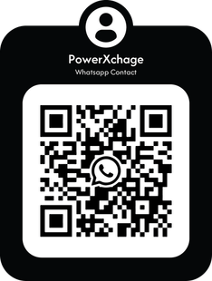
THANK YOU
Get in Touch

