Slide 1
Interstate Peer-to-Peer Energy Trading Pilot – Lessons Learned · Best Practices · Hurdles · Way Forward
23rd June 2026
BSES: 23 years of serving the National Capital

Slide 2
P2P Process and Architecture
1

Slide 3
Table of Content
P2P Process and Architecture
  Pilot Context : Why Interstate P2P Matters
  P2P Architecture
  P2P Trade – 3 Layered Flow
P2P Pilot at BRPL
  P2P Pilot at BRPL — Snapshot
  Trade Performance — Results Till 16 June 2026
  Bill Settlement — Making P2P Visible & Auditable
  Best Practices — What BRPL Built
  Operational Monitoring — From Pilot to Control Room Discipline
Challenges, Hurdles & Policy Gaps
  Challenges & Hurdles
  Regulatory & Policy Gaps
Way Forward
  Way Forward — Recommendations
  Key Takeaways

Slide 4
Pilot Context: Why Interstate P2P Matters
A practical model to connect distributed green energy with willing consumers
Consumer choice
Pilot objectives
Consumers can access green energy from prosumers through approved trading platforms and transparent settlement.
Enable secure onboarding through DISCOM-issued Verified Credential (VC).
Demonstrate interoperability across multiple trading platforms via IES Common Data Service and Ledger.
Validate actual import / export using smart meter data after trade day.
Apply allocation logic when committed energy differs from actual generation / consumption.
Settle final P2P units in monthly consumer and prosumer bills.
Prosumer monetization
Rooftop solar surplus receives a market-linked opportunity beyond traditional net-meter adjustment.
DISCOM-managed trust
DISCOM remains the source of consumer identity, meter validation, energy accounting and billing adjustment.
Pilot lens: technology + regulation + operations + consumer experience must work together.

Slide 5
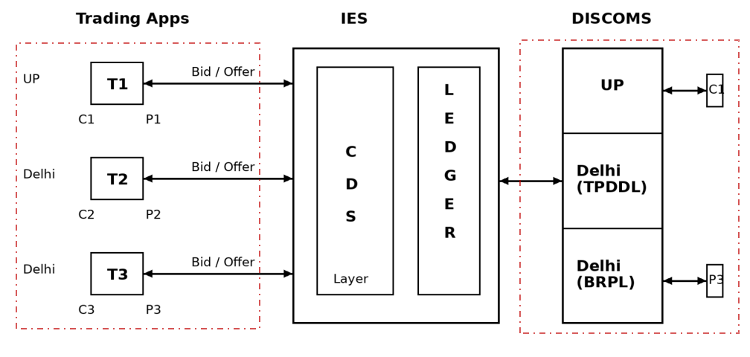
B. P2P Architecture
Trade platform ecosystem, India Energy Stack, and DISCOM systems operate as a connected chain
Core principle: trading apps match and settle wallets; IES publishes and records commitments; DISCOM validates actual energy and settles bills.

Slide 6



C. P2P Trade Architecture — Three Layers
BRPL's integration with India Energy Stack (IES)
LAYER 1
Trade Platform Ecosystem
▸ Kazam Energy | Terra Rex Energy | Pulse Energy
▸ Consumer places Bid / Prosumer places Offer for a time slot
▸ Trade matching, wallet settlement, consumer-facing app
LAYER 2
India Energy Stack (IES)
▸ Common Data Service (CDS): publishes all bids & offers from all platforms
▸ Trade Ledger: stores committed trades, receives validated units from DISCOMs
▸ Enables interoperability across states & prevents over-allocation
LAYER 3
DISCOM Ecosystem (BRPL)
▸ VC Issuance Portal → Smart Meter (AMI/HES/MDMS) → P2P Validation Engine
▸ Validate meter data against trades on T+1; apply pro-rata allocation logic
▸ Final settled units pushed to Ledger; monthly billing via SAP integration
Allocation rule used by BRPL: Final P2P units = lower of committed energy and actual metered import / export. If actual generation / consumption is less than committed and multiple participants are involved, pro-rata allocation is applied.
Notes:
The P2P trade operates across three layers. Layer 1 is the trade platform where consumers and prosumers interact through apps like Kazam, Terra Rex, or Pulse Energy. Layer 2 is the India Energy Stack — a central interoperability layer with a Common Data Service that publishes all bids and offers, and a Trade Ledger that stores committed trades and receives validated units from DISCOMs. Layer 3 is where BRPL does the heavy lifting — we validate meter data, run pro-rata allocation logic, and push final settled units back to the ledger, then reflect them in monthly bills.

Slide 7
P2P Pilot at BRPL
2

Slide 8





D. P2P Pilot at BRPL — Snapshot
As on 16th June 2026 | Under DERC Order dated 11.02.2026
43
191
417
3
Participants
(8 Prosumers + 35 Consumers)
Trades
Registered
kWh
Traded
DISCOMs
Participating
Key Context
Trade Platforms
DERC Order 11.02.2026 approved pilot for 6 months under P2P Transaction Guidelines 2024
BRPL initiated all necessary actions — consumer onboarding, platform integration, billing
Total sanctioned load of participating consumers / prosumers over 300 KW
Bid/offer of 673 kWh placed; 417 kWh (62%) successfully traded
Kazam Energy
31 kWh traded
Terra Rex Energy
52 kWh traded
Pulse Energy
333 kWh traded
Notes:
The P2P pilot was approved by DERC on 11 February 2026. As of June 16th, we have 43 participants — 8 prosumers who have rooftop solar and 35 consumers — across three DISCOMs: BRPL, TPDDL, and PVVNL. 191 trades have been registered with 673 kWh of energy offered, and 417 kWh actually traded. Three trade platforms are active: Kazam Energy, Terra Rex Energy, and Pulse Energy.

Slide 9
E. Trade Performance — Results Till 16 June 2026
191 trades · 673 kWh offered · 417 kWh settled
Units Traded by Platform (kWh)
Units Traded by DISCOM Corridor (kWh)
Settlement Summary by Platform
Trade Platform | Role | Consumer Count | Prosumer Count | Units Traded (kWh)
Kazam Energy | Prosumer + Consumer | 4 | 2 | 31
Terra Rex Energy | Prosumer + Consumer | 0 | 2 | 52
Pulse Energy | Consumer only | 2 | 6 | 333
Total |  |  |  | 417 kWh
Notes:
Looking at the trade performance: Pulse Energy has dominated with 333 kWh traded, followed by Terra Rex at 52 kWh, and Kazam at 31 kWh. In terms of interstate corridors, PVVNL to BRPL is the most active route, while BRPL to TPDDL trades are still limited. The bid-to-trade ratio averages around 62%, which is quite healthy for a pilot phase.

Slide 10
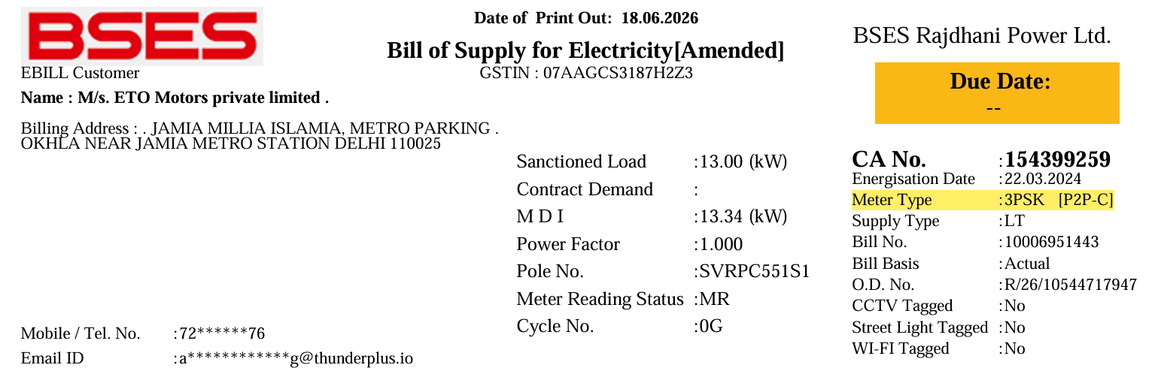
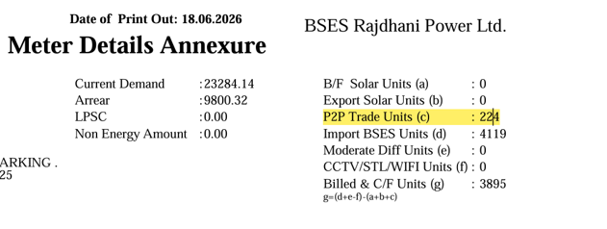
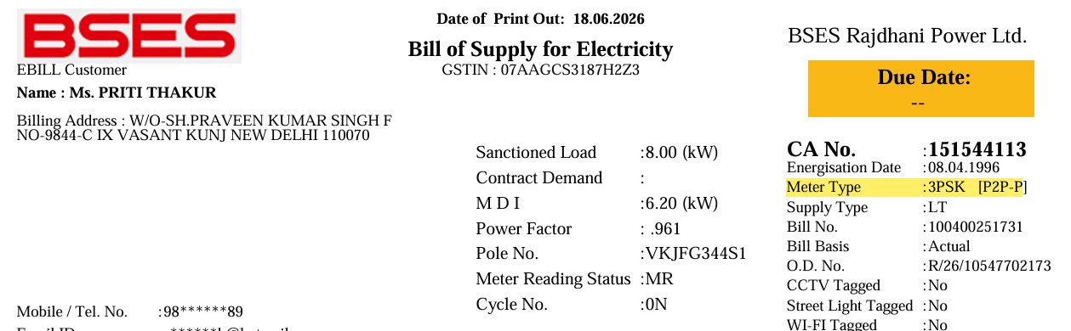
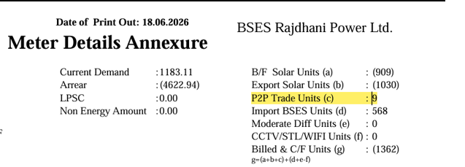
F. Bill Settlement — Making P2P Visible & Auditable
Final P2P units were reflected in the electricity bill for both consumer and prosumer
For Consumer
For Prosumer
Notes:
BRPL developed six key innovations during this pilot. First, a self-service consumer portal for VC generation — consumers just enter their CA number, receive an OTP, and get their Verified Credential instantly. Second, a dedicated P2P Monitoring Cell that watches every trade daily. Third, a 4-module dashboard suite covering trade status, buyer/seller details, smart meter replacement requests, and meter communication health. Fourth, deep integration with AMI/HES/MDMS systems for automated meter data retrieval. Fifth, a validation and allocation engine with T+1 settlement and pro-rata logic. Sixth, full SAP billing integration for automated monthly settlement.

Slide 11


G. Best Practices — What BRPL Built
Innovations developed during the pilot to ensure smooth operations
Consumer Portal & VC Generation
Dedicated P2P Monitoring Cell
Self-service web portal (https://www.bsesdelhi.com/web/brpl/p-to-p-trading) for scheme awareness and instant Verified Credential (VC) issuance using CA No. + OTP — no manual visit needed.
A specialist team monitors pending trade allocations, resolves smart meter communication failures, coordinates with MMG for meter replacement, and validates monthly bill settlements.
4-Module Trade Monitoring Dashboard
AMI/HES/MDMS Integration
Real-time dashboards for: (1) All Trades status, (2) Buyer/Seller trade details, (3) P2P interest window for smart meter replacement requests, (4) Meter communication health.
Smart meter data (import/export) is pulled directly from MDMS/HES. A combined P2P Communication Dashboard avoids the need to visit separate HES/MDM applications.
P2P Validation & Allocation Engine
SAP Billing Integration
Validates traded quantity vs. actual meter energy, applies pro-rata logic when export < committed units, T+1 settlement, publishes final units to IES Trade Ledger.
P2P traded units are reflected in monthly consumer bills via SAP integration — prosumer export deducted, consumer import adjusted — fully automated reconciliation.
Notes:
BRPL developed six key innovations during this pilot. First, a self-service consumer portal for VC generation — consumers just enter their CA number, receive an OTP, and get their Verified Credential instantly. Second, a dedicated P2P Monitoring Cell that watches every trade daily. Third, a 4-module dashboard suite covering trade status, buyer/seller details, smart meter replacement requests, and meter communication health. Fourth, deep integration with AMI/HES/MDMS systems for automated meter data retrieval. Fifth, a validation and allocation engine with T+1 settlement and pro-rata logic. Sixth, full SAP billing integration for automated monthly settlement.

Slide 12
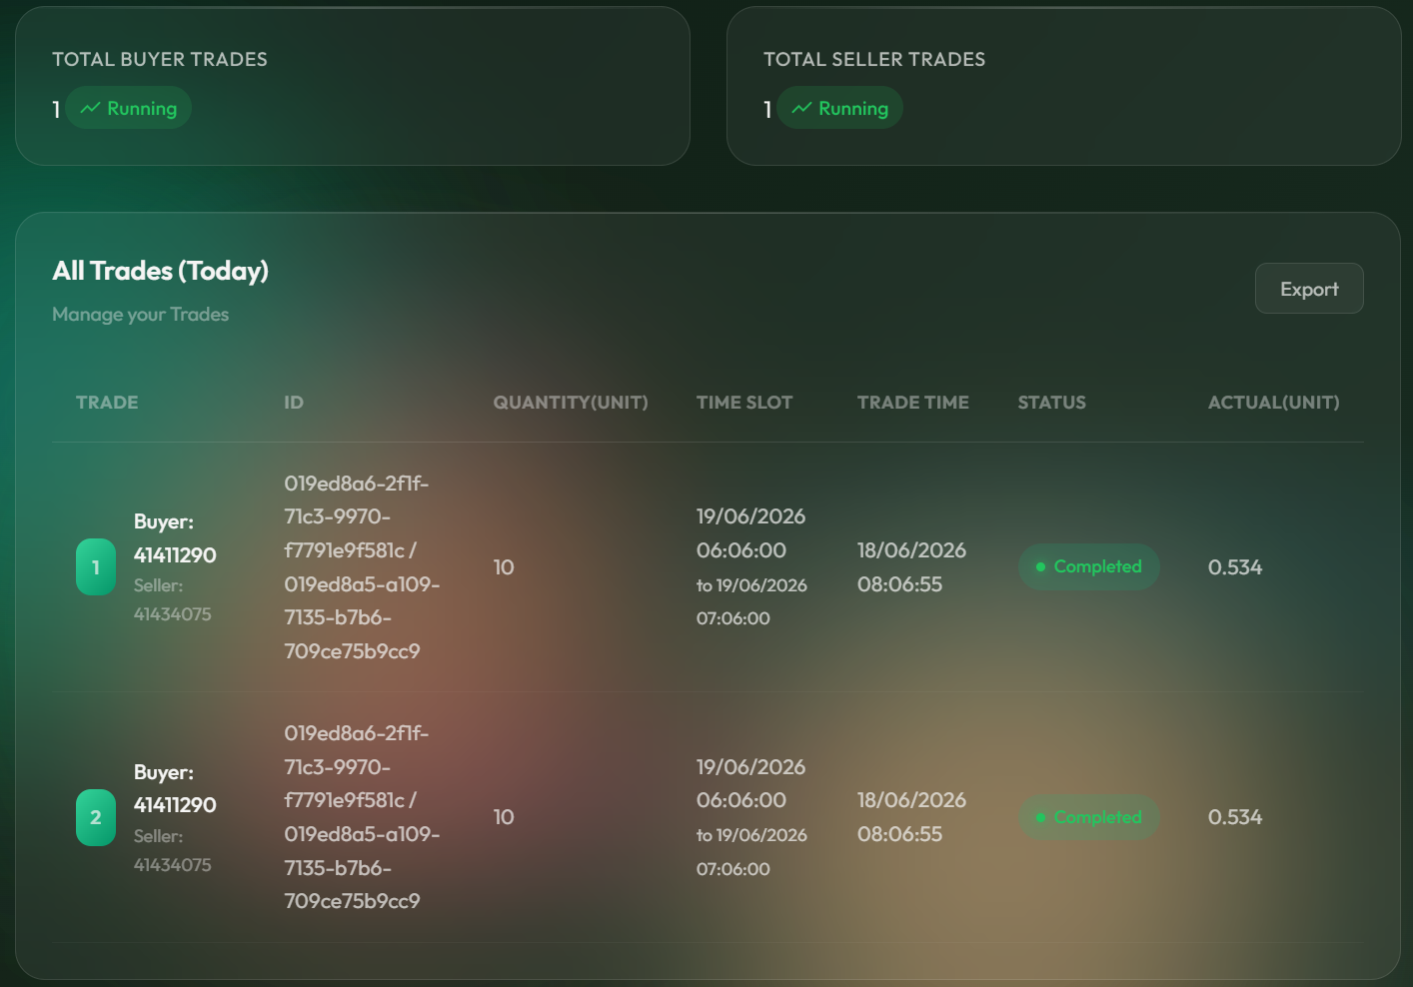
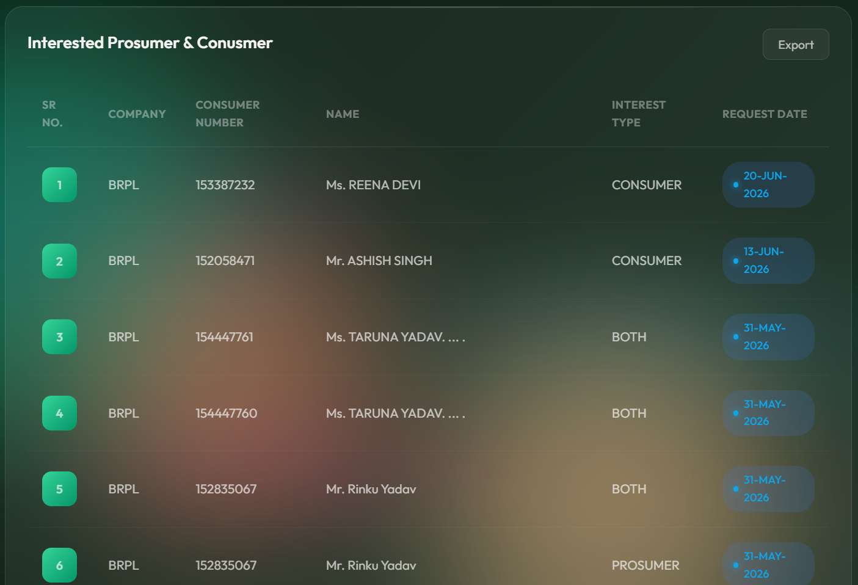
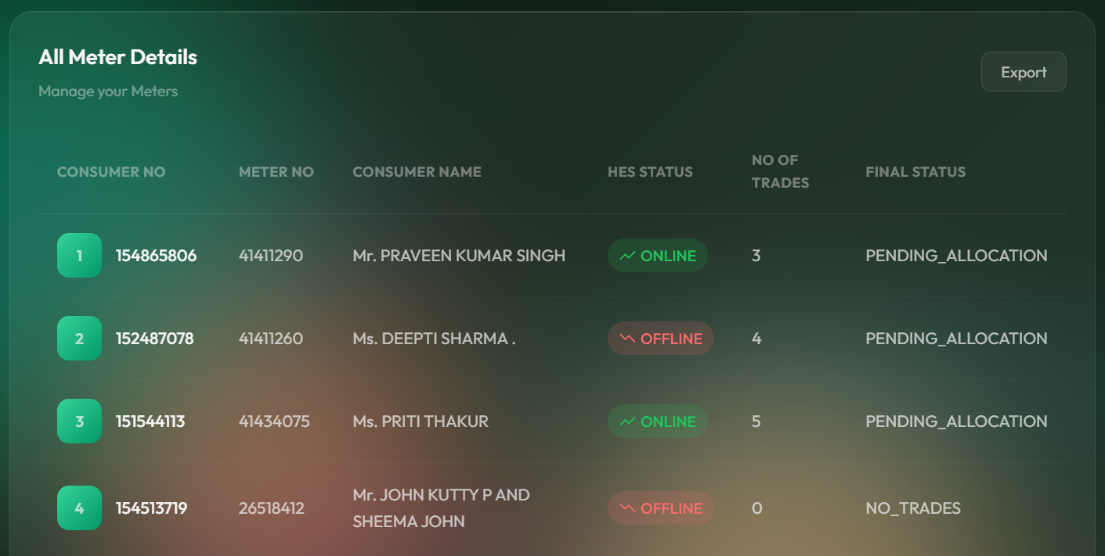
H. Operational Monitoring — From Pilot to Control Room Discipline
Dashboards helped reduce dependency on multiple applications and enabled exception-based operations
Interest window: smart meter change requests
Buyer / seller trade visibility
Meter communication status for P2P participants
Scale-up requirement: institutionalize the monitoring cell as a DISCOM P2P operations desk with daily exception handling
Notes:
BRPL developed six key innovations during this pilot. First, a self-service consumer portal for VC generation — consumers just enter their CA number, receive an OTP, and get their Verified Credential instantly. Second, a dedicated P2P Monitoring Cell that watches every trade daily. Third, a 4-module dashboard suite covering trade status, buyer/seller details, smart meter replacement requests, and meter communication health. Fourth, deep integration with AMI/HES/MDMS systems for automated meter data retrieval. Fifth, a validation and allocation engine with T+1 settlement and pro-rata logic. Sixth, full SAP billing integration for automated monthly settlement.

Slide 13
Challenges, Hurdles & Policy Gaps
3

Slide 14
Operational & Technical Challenges
I. Challenges & Hurdles
Key operational and Regulatory challenges encountered during the pilot
01
VC Revocation Mechanism Absent
02
Onboarding & Meter Readiness
03
Bid vs. Actual Energy Gap
Identity & VC
Consumer Readiness
Settlement
No workflow to revoke or reissue VCs on ownership transfer, meter change, or connection events. Active BRPL case: a consumer trading post-ownership transfer cannot settle — no fresh VC process exists.
.
Not all interested consumers have smart meters. Coordinating MMG (Meter Management Group) for meter replacement delays the active participant pipeline significantly.
Prosumers often bid more than they actually export. Pro-rata logic handles the shortfall, but consumers receive less energy than contracted — impacting their confidence.
04
Interstate Coordination Gap
05
Low Consumer Participation
06
Pilot Period Too Short
Multi-DISCOM
Awareness
Regulatory
Synchronising meter data deadlines and ledger writes across BRPL, TPDDL, and PVVNL involves multiple IT systems with differing processes and timelines.
Despite a dedicated portal and consumer guide, voluntary sign-up remains low. Prosumer participation is especially limited; targeted campaigns in high-solar areas are needed.
First 3 months consumed during process streamlining; meaningful scale data could not be gathered. BRPL shall seek directives from DERC to extend the pilot period.
07
Allocation Trust Deficit
09
Energy Gifting Scenario to be Developed
Governance & Trust
Platform Gap
Each DISCOM applies its own independent allocation logic — creating inconsistency and trust issues for platforms and participants. A neutral IES-managed centralised allocation engine with standardised rules is essential.
A BRPL prosumer gifting solar energy to their own household cannot proceed — trade platforms reject zero-cost transactions and do not provide a gifting mode or self-selection option. Platforms must support ₹0 trades as a valid energy-gifting use case.
Notes:
Nine operational challenges. 01-06 are day-to-day operational issues. 07: Allocation trust deficit — DISCOMs using different logic creates inconsistency. IES needs to own the centralised allocation engine. 08: VC Revocation absent — active BRPL consumer cannot settle after ownership transfer. 09 (NEW): Energy Gifting — a prosumer trying to gift solar to their own household is blocked because platforms do not allow ₹0 trades or a gifting mode.

Slide 15
J. Regulatory & Policy Gaps
Critical framework gaps that must be resolved before P2P can scale
R1
Grid & Scheduling
Uniform DSM for P2P
R2
Energy Accounting
Energy Accounting
No uniform mechanism exists for treatment of under-drawl, over-drawl, under-injection, and over-injection by P2P participants. A dedicated DSM framework is required to ensure grid stability and fair settlement.
Clear procedures for energy accounting, scheduling, metering validation, and settlement by SLDCs/NLDC are absent for interstate P2P transactions. A harmonized framework is needed for accurate settlement.
R3
Loss Allocation
Risk
R4
Tariff Policy
Charges
Regulatory clarity is required on treatment of transmission and distribution losses for P2P traded energy and identification of the entity responsible for bearing such losses.
Methodology for determination of transaction fees, platform charges, wheeling charges, and network usage charges has not been specified, creating commercial uncertainty
R5
Consumer Eligibility
Authentication
R6
Liability and Final Settlement
Governance
Regulations do not clarify whether consumers belonging to the same tariff category can participate in P2P transactions and how tariff neutrality and cross-subsidy concerns will be addressed.
Responsibilities are also not clearly assigned for cases like identity fraud, allocation failure, or grid emergency. This may create financial risk for DISCOMs, platforms, and consumers. Therefore, a clear IES framework for liability and final settlement is required.
Notes:
Six regulatory gaps from BSES IES Strategy review. R1: liability, R2: jurisdiction, R3: market safeguards, R4: DSM, R5: wheeling/CSS, R6: platform regulation (now also mentions energy gifting mandate).

Slide 16
Way Forward
4

Slide 17







K. Way Forward — Recommendations
8 priority actions for a scalable, trustworthy interstate P2P market
Extend Pilot
Scale to 1000+ Participants
Smart Meter Priority Queue
Centralised IES Allocation Engine
Short-Term
Short-Term
Infrastructure
IES Governance
First 3 months consumed by initial process streamlining. A further extension is needed for scaling pilot.
Targeted campaigns in high-solar-density areas. Streamline VC generation and reduce onboarding friction. Set 1000+ participant target for the extended pilot period.
Create a priority queue for smart meter installation & AMI communication uptime for P2P-registered consumers. Meter readiness is the single biggest daily operational bottleneck.
IES to implement a neutral centralised allocation engine with standardised pro-rata logic. DISCOMs write meter data; IES performs allocation — ensuring consistent, trusted settlement across all trade corridors.
VC Revocation & Lifecycle Mgmt
Mandate Energy Gifting Support
Regulatory Clarity: DSM, Liability & Jurisdiction
Multi-State Expansion & DISCOM Incentives
IES / Identity
Platform Design
Regulatory
Long-Term
Implement VC revocation protocols on ownership transfers, meter replacements, and connection changes. Auto-issue fresh VCs on DISCOM lifecycle events to prevent stale-credential settlement failures.
Platform providers must support zero-cost (₹0) energy gifting transactions with a dedicated gifting mode and self-selection option. CERC/platform regulations should mandate this as a standard use case alongside commercial P2P trade.
CERC to clarify interstate P2P jurisdiction, define DSM for scheduling gaps, establish settlement finality rules, and assign liability chain. Issue model SERC regulation. Define wheeling, CSS, and platform operator standards.
Leverage IES interoperability to onboard more states and platforms. Introduce wheeling margin or transaction fee to incentivize DISCOM participation. Share BRPL learnings via AIDA to accelerate national rollout.
Notes:
Eight priority actions: extend pilot, scale participation, smart meter queue, centralised IES allocation engine, VC revocation, mandate energy gifting support, regulatory clarity, and multi-state expansion.

Slide 18
L. Key Takeaways
BRPL successfully launched India's first interstate P2P pilot, trading 417 kWh across 3 DISCOMs and 3 platforms
Dedicated monitoring cell + automated dashboards are essential — don't underestimate the operational overhead of a live P2P market
IES needs two urgent upgrades: Centralised Allocation Engine (trust & consistency) and VC Revocation (identity lifecycle management)
Trade platforms must address real-world edge cases: zero-cost energy gifting, self-directed prosumer-to-household trades must be supported
Consumer awareness and simplicity of onboarding will drive adoption — digital VC issuance was the right call
Request to DERC: extend pilot and provide policy clarity on pricing & dispute resolution
Six regulatory gaps must be closed: DSM, liability framework, CERC/SERC jurisdiction, market safeguards, wheeling policy, platform regulation
Notes:
To summarise: BRPL has demonstrated that interstate P2P energy trading is operationally feasible. We've traded 417 kWh, built a complete monitoring and settlement stack, and integrated with the IES framework. The lessons are clear: smart meter infrastructure is non-negotiable, operational monitoring is critical, and consumer education takes consistent effort. We look forward to extending the pilot and sharing these learnings with the broader DISCOM community. Thank you.

Slide 19

Thank
You

Slide 20
I. Data & Integration Model — What BRPL Built
P2P depends on trusted identity, interval meter data, ledger write-back and billing controls
Eligibility
Smart meter / net meter check before VC generation
Master hygiene
CA, meter number, ownership and meter change consistency
Settlement traceability
Ledger response, SAP bill flag and monthly reconciliation
Meter communication
Availability of interval data for the traded time slot
Data control points
Notes:
BRPL developed six key innovations during this pilot. First, a self-service consumer portal for VC generation — consumers just enter their CA number, receive an OTP, and get their Verified Credential instantly. Second, a dedicated P2P Monitoring Cell that watches every trade daily. Third, a 4-module dashboard suite covering trade status, buyer/seller details, smart meter replacement requests, and meter communication health. Fourth, deep integration with AMI/HES/MDMS systems for automated meter data retrieval. Fifth, a validation and allocation engine with T+1 settlement and pro-rata logic. Sixth, full SAP billing integration for automated monthly settlement.

