Slide 1

Demand Forecasting Strategy
& Insights
Tata Power Mumbai Distribution
24th June 2026

Slide 2
Why Forecasting Matters ??
Demand Forecasting
Planning Resources
Procurement
Planning Dispatch
Real Time Management
Accounting & Reconciliation
Every 1% improvement in Load forecasting accuracy tentatively impacts the Power Purchase Cost by 0.5 % - 1.5 %

Slide 3
Tata Power Mumbai Distribution
Overview

Slide 4
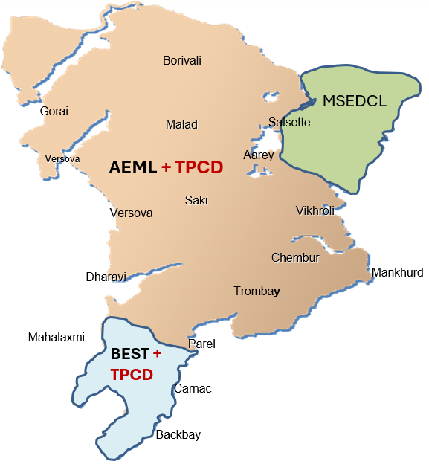
DIRECT
WELCOME
TPCD Demand
With Captive Generation

Slide 5




1
Consumer Base
8 Lakhs +
2
Annual Energy Requirement
6,200 Mu+
3
Peak Demand
1,315 MW

Slide 6
Demand Forecasting Framework at TPC Mumbai
Long/Medium Term
Short Term
10 Years – 1 Year
Monthly and Weekly
Day Ahead and Real-time
CAGR, New Consumer Additions, City Planning, Trend Analysis, Penetration of EV & Solar Roof top, Impact of policies/consumer migration etc.
Seasonal Pattern, Approximate Weather Patterns/changes, Holidays, Weekends etc.
Recent Demand, Fairly accurate weather pattern etc.

Slide 7
Long / Medium Term Demand Forecasting Framework

Slide 8
LT/MT Demand Forecasting
Existing Consumers
Industrial Load
Weather Dependant Load
New Consumer Additions
Welcome Consumers
Total Forecasted Load
Historical Trend
Open Access Scenario
CAGR
Trend Analysis
Tariff Signals
Policy Push
Natural Growth
Consumer Migration
Category-wise sales
Policy Drivers

Slide 9
Load Research For LT/MT Forecasting

Slide 10
Load Research For LT/MT Forecasting

Slide 11
Load Research For LT/MT Forecasting

Slide 12
Demand Forecasting Results – LT/MT

Slide 13
Short-Term Demand Forecasting Framework

Slide 14



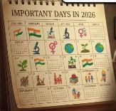

ST Demand Forecasting
Short-Term Forecast Drivers
Weather
Day-of-the-week
Holidays
Special Events
Recent Demand
Temperature
Humidity
Rainfall
Weekday
Working/Non-working Saturday
Sunday
Festivals
National Holiday
Earth Hour
Elections
Sport Events
Seasonal Variations

Slide 15
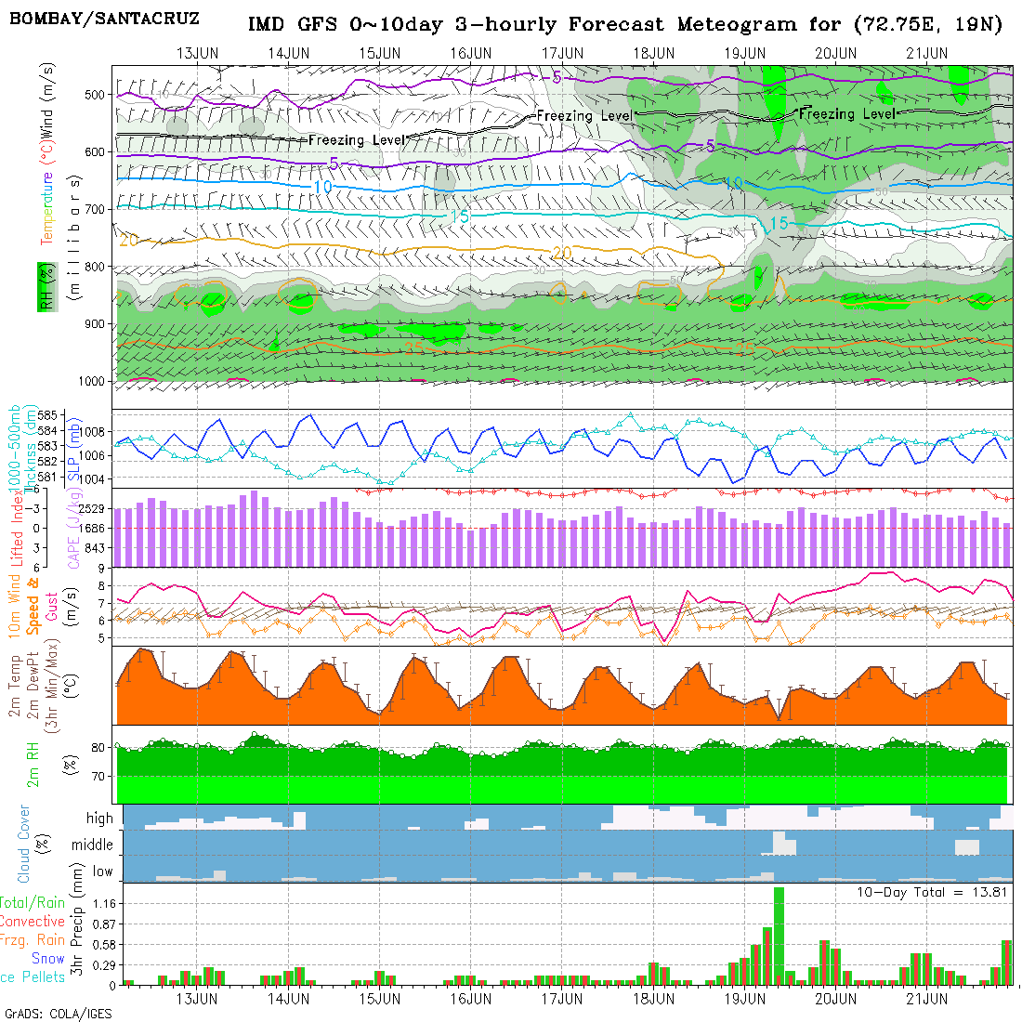
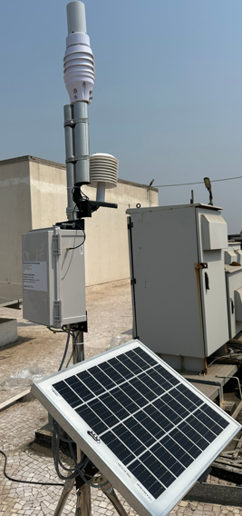
Systems Available For Demand Forecasting
Weather Forecasting Platforms
Automatic Weather Stations
SCADA
ABT Interface Metering System
Smart Meters
AI+ML Based Application

Slide 16
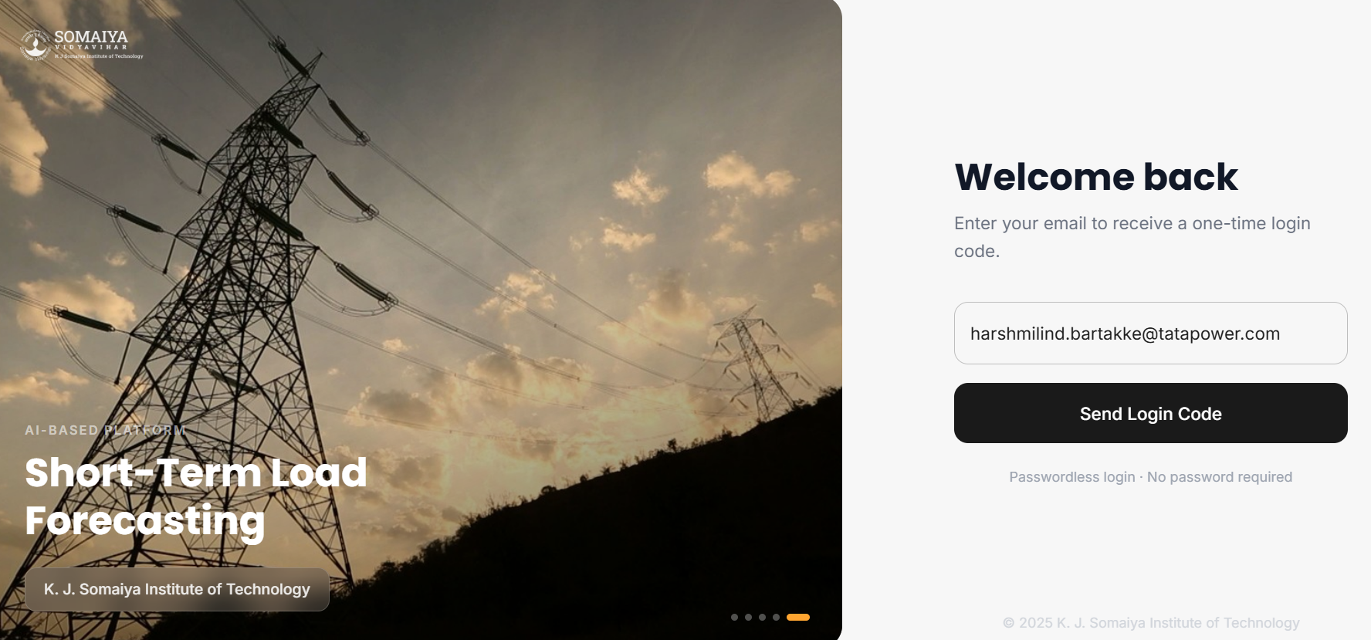
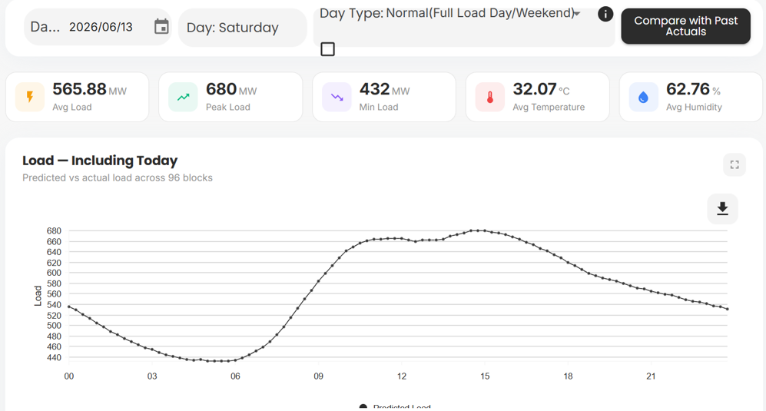
AI+ML Based ST Demand Forecasting
Historical Data + Weather
Model
Forecast

Slide 17
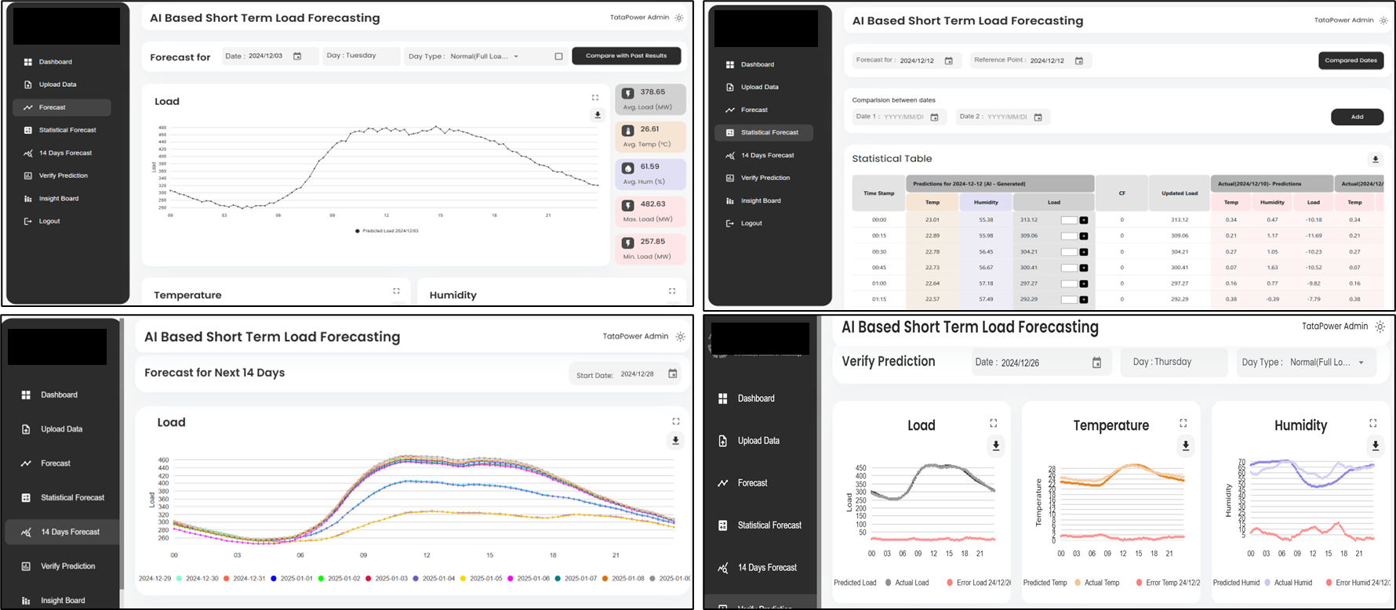
AI+ML Based ST Demand Forecasting

Slide 18
Forecasting Challenges
LT Forecast * Accurate Peak Forecasting
* Welcome Consumers Demand
Impact of unexpected light showers
ST Forecast * Weather driven Volatility
(Co-relation with Category-wise Demand)
* Handling Special Events
* Different Models for different Horizons
Load Drop due to unexpected Rain

Slide 19
THANK YOU

