Slide 1
Presentation to AIDA Workshop
ISGF Initiatives on
Peer–to–Peer (P2P) Trading of Rooftop Solar Energy
Presented By
Reena Suri
Executive Director
India Smart Grid Forum

Slide 2
Peer-to-Peer (P2P) Trading of Rooftop Solar Energy – Pilots in India
Three successful pilot projects of P2P Trading of Rooftop Solar Energy on blockchain platform were carried out by ISGF and our technology partner Powerledger in India between 2020 and 2022
1. Uttar Pradesh (UP), India
Pilot implemented under the regulatory sandbox approach to test the technical feasibility and customers willingness to participate in P2P trading
12 participants (9 prosumers and 3 consumers) were recruited in the pilot project - Project Go-Live: Dec 2020
Pilot project price discovery was around INR 5.60/kWh (Win-Win for Prosumers and Consumers)
UP Electricity Regulatory Commission (UPERC) issued P2P Regulations in April 2023
2. Delhi, India
P2P trading of solar power from over 2 MW of solar PV undertaken in 2021 in Delhi with Tata Power Delhi Distribution Ltd (TPDDL)
117 participants were identified and recruited in the pilot project; Project Go-Live: Nov 2021
Based on the project results, ISGF + Powerledger + TPDDL had submitted detailed findings and recommendations to Delhi Electricity Regulatory Commission (DERC) in November 2021
DERC published Peer to Peer Energy Transaction Guidelines, 2024 in June 2024
3. Kolkata, India
Built a P2P trading platform on blockchain for CESC Kolkata in 2022 and run a 6-month pilot with 1002 C&I Customers with AMR meters (26 MW PV installations); Project Go-Live: August 2022
Formulated a viable business model for CESC
Documented the outcomes of the project; but not yet presented to West Bengal Electricity Regulatory Commission (WBERC)

Slide 3
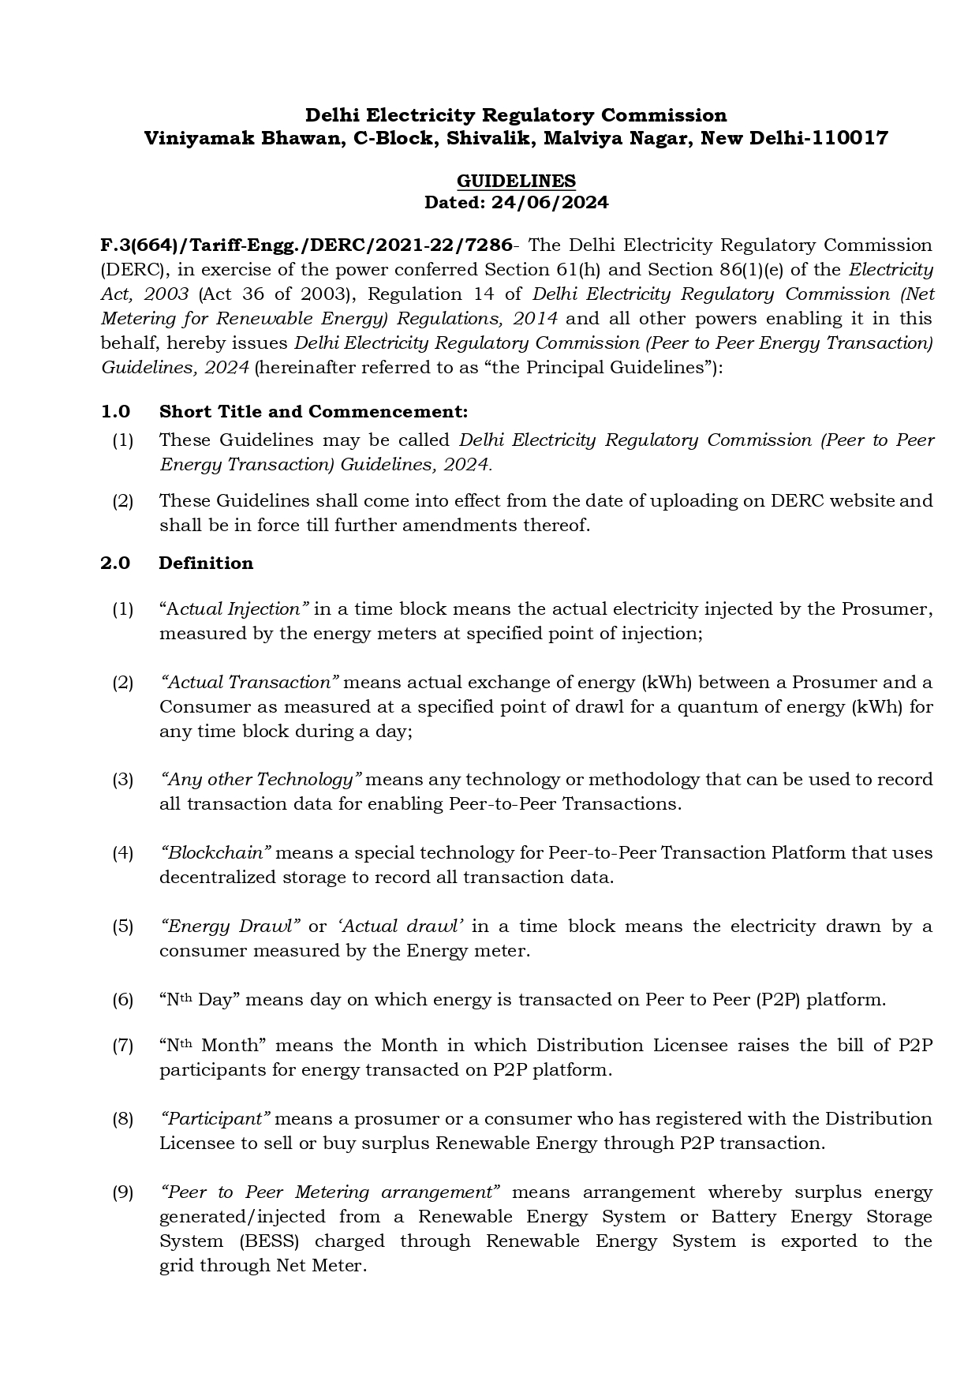
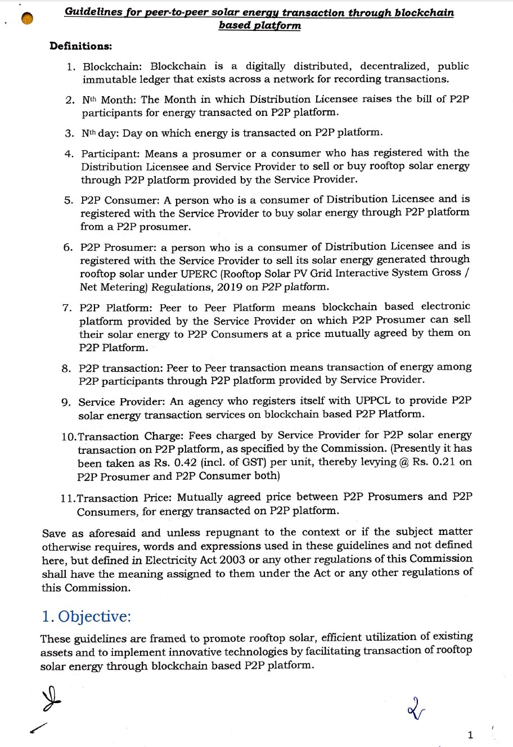
P2P Guidelines in UP and Delhi
Guidelines for Peer-to-Peer Solar Energy Transaction through Blockchain by UPERC in April 2023
Peer to Peer Energy Transaction Guidelines, 2024 by DERC in June 2024
Link: https://shorturl.at/p1SQx
Link: https://shorturl.at/PiqH4

Slide 4
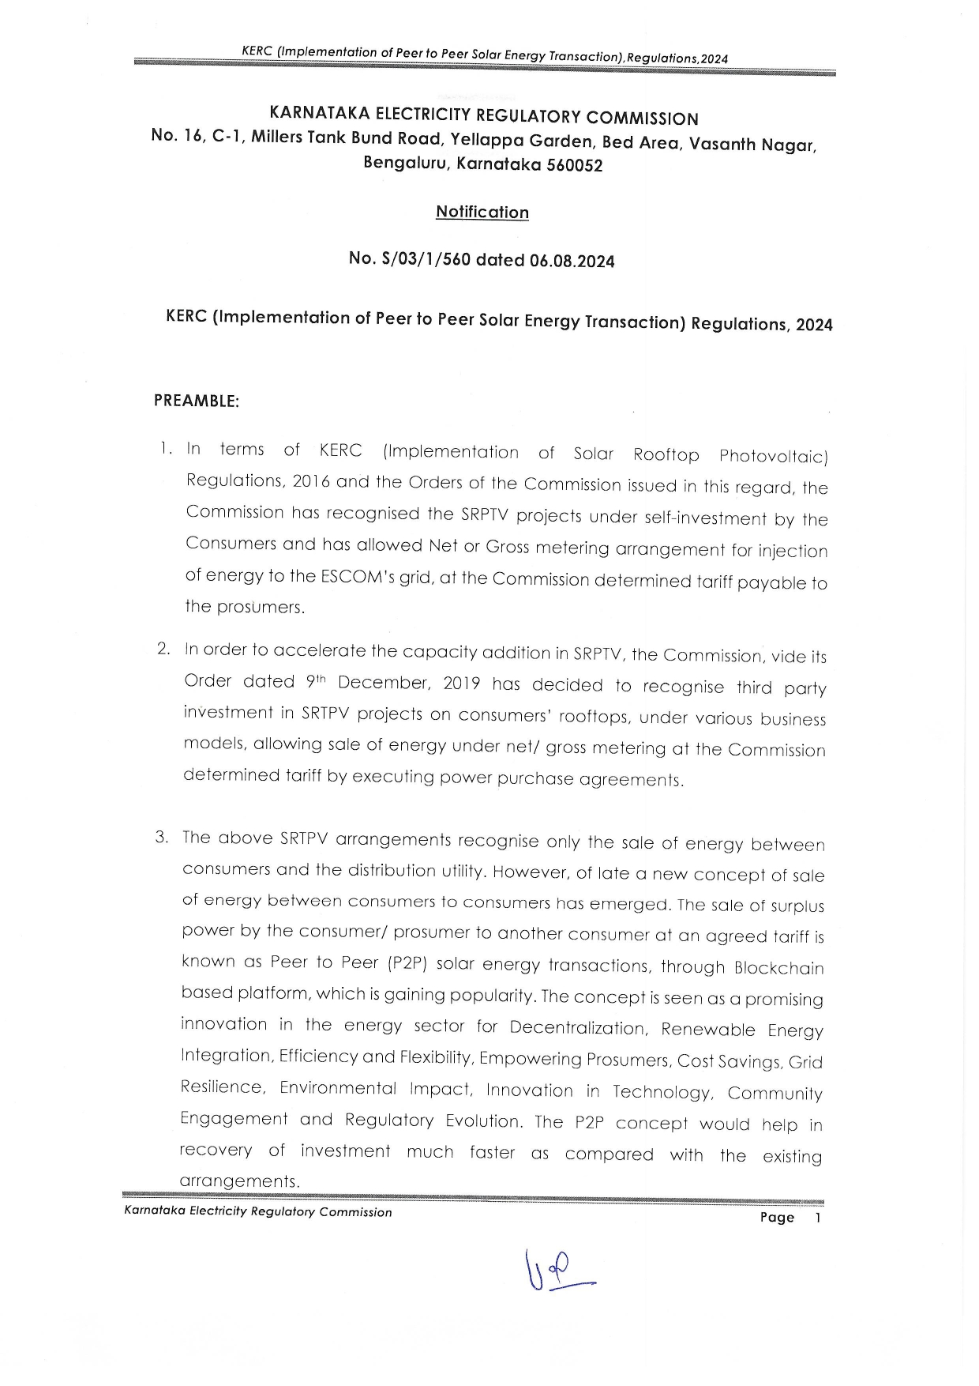
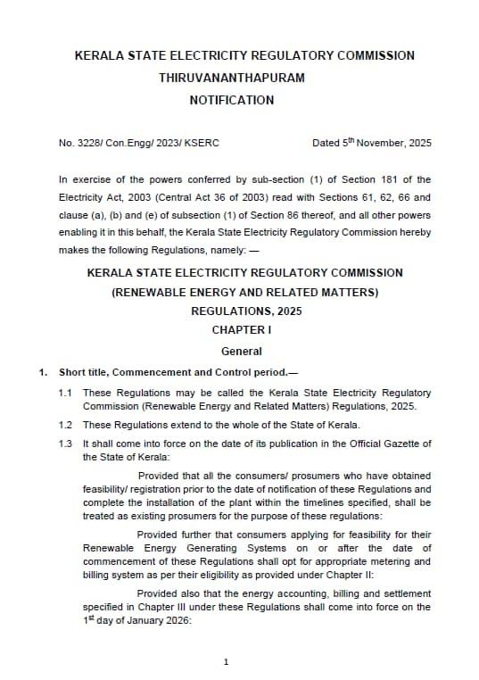
P2P Regulations in Karnataka and Kerala
Implementation of Peer to Peer Solar Energy Transaction Regulations by KERC in August 2024
Renewable Energy and Related Matters Regulations, 2025 by KSERC in November 2025
Link: https://shorturl.at/uK6id
Link: https://shorturl.at/8vtAx

Slide 5
Key Features of the UPERC and DERC Guidelines and Karnataka Regulations
  The UPERC Guidelines Species clear guidelines on Trading Rules:
  - Energy Charges (kWh) to be mutually agreed between the Buyer (Consumer) and the Seller (Prosumer)
  - Buyer to pay Rs 0.92/kWh to the DISCOM
  - Buyer and Seller to pay Rs 0.21/kWh to the Platform Service Provider (42 paise including GST)
  Seller to compensate the Buyer incase the promised volume is not exported to the grid (deviation to be settled at the difference between the Buyers Tariff and mutually agreed rate of P2P sale
  Per these guidelines, the responsibility for collection of energy charges and platform fees are with the DISCOMs
  DERC Guidelines are open – the DISCOMs to submit their petitions and get it approved by DERC
  In Delhi only TPDDL and NDMC have smart meters – TPDDL plan to submit petition after the Lucknow project
  Karnataka Regulations are vague – it allows only residential consumers to trade amongst them; platform service fee is provisionally mentioned as 14 paise/kWh
  No smart meters in Karnataka
  Although UPERC issued regulations in April 2023, UPPCL expressed difficulties in collecting money from Buyers and Sellers which require extensive modifications in their Billing System
  ISGF proposed the UEI Architecture for P2P Transactions in 2024; and UPPCL issued RFP to empanel Service Providers in August 2024; and issued LOI to 4 agencies in March 2025

Slide 6
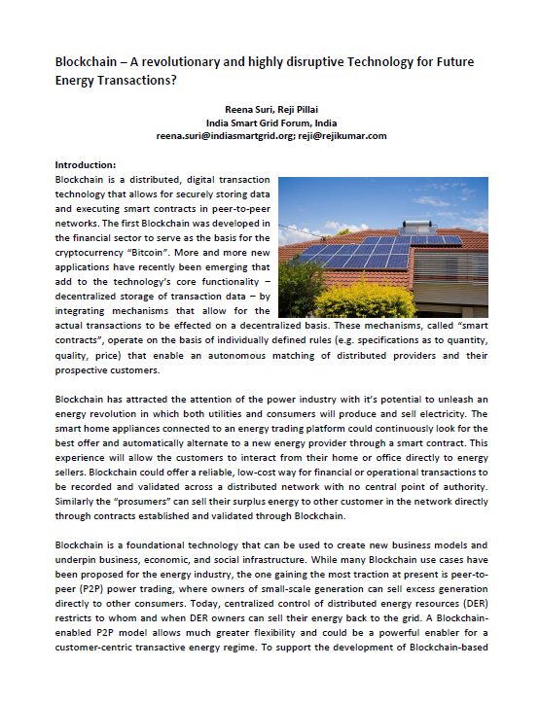
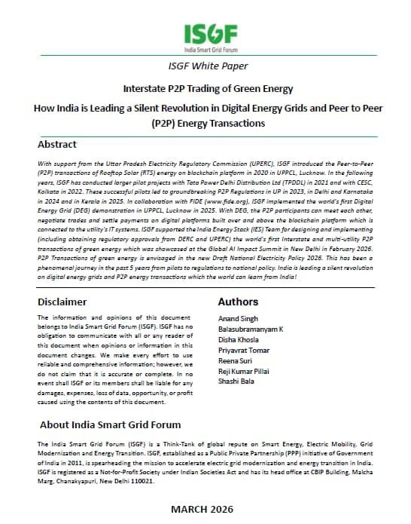
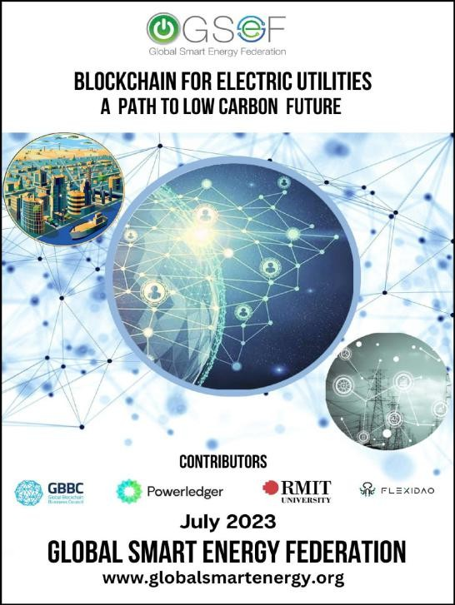
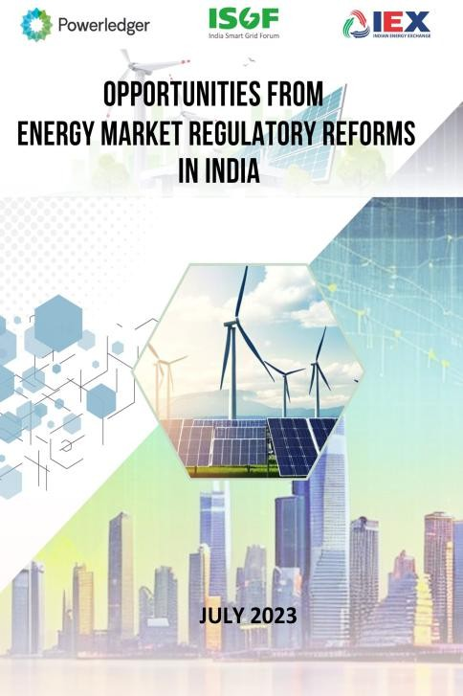
ISGF White Papers on P2P Trading on Blockchain Platforms
Blockchain – A Revolutionary and Highly Disruptive Technology for Future Energy Transactions (2017)
Opportunities from Energy Market Regulatory Reforms in India (2023)
Interstate P2P Trading of Green Energy How India is Leading a Silent Revolution in Digital Energy Grids and P2P Energy Transactions (2026)
Blockchain for Electric Utilities A Pathway to Low Carbon Future (2023)
Link: https://shorturl.at/Lp92W
Link: https://tinyurl.com/u45534j7
Link: https://shorturl.at/ScmVC
Link: https://shorturl.at/dw1dq

Slide 7
First Digital Energy Grids (DEG) based on Unified Energy Interface (UEI) Architecture in Lucknow

Slide 8
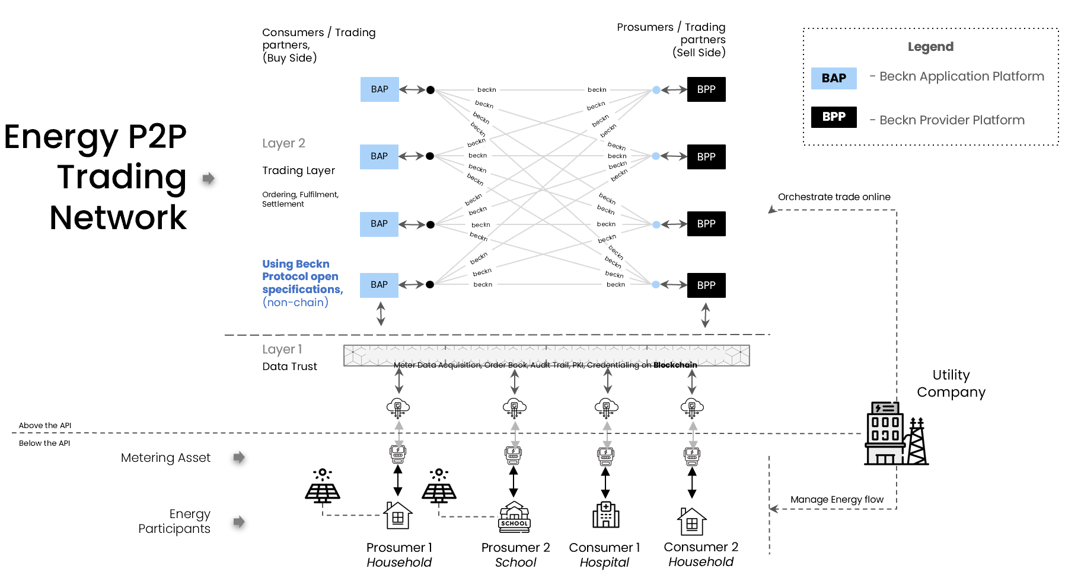
Energy P2P Trading Network – Beckn Protocol

Slide 9
Brief Profile of Stakeholders Associated with the Pilot
Sl. No. | Company | Profile
1 | UPPCL | UPPCL and their DISCOMS will test and rollout the digital platforms for P2P trading of rooftop solar energy.
2 | Intellismart | Supporting ISGF in successfully implementing this project by deploying their smart meters on our buyer platform, along with integrating their MDM and RMS with our system
2 | FIDE | FIDE (Foundation for Interoperability in Digital Economy) is a not-for-profit organization founded by Nandan Nilekani, Pramod Varma, and Sujith Nair. It is the originator of the Beckn Protocol, an open-source digital framework launched in 2019 to support decentralized and inclusive digital ecosystems. FIDE governs the protocol as a digital public good under a Creative Commons license and continues to support its evolution and adoption globally, working with volunteers and stakeholders to promote interoperability in the digital economy.
3 | Trillectric | Trillectric Gridmend Private Limited is driven by a vision to enable the transformation of the power and grid sectors. With the rise in energy demands, renewable energy (RE) injections, and the growth of prosumers—consumers who also produce energy—Trillectric is at the forefront of addressing the overlapping of demand and supply sides, distributed energy resources, and smart grid advancements. Trillectric aims to build a comprehensive ecosystem of cutting-edge hardware and software solutions, supported by industry experts, to scale and enable these transitions.
4 | KrypC | KrypC is a global blockchain technology company with a proven track record of delivering 70+ successful blockchain projects worldwide. Committed to empowering enterprises, startups, and developers, KrypC drives innovation in the Blockchain and Web3 ecosystems. Specializing in enterprise-grade blockchain solutions, KrypC serves both public and private sector clients. With a focus on simplicity, cost-efficiency, and risk mitigation, the company enables its clients to seamlessly build, deploy, and manage cutting-edge blockchain applications tailored to their needs.
5 | Kazam | Kazam EV Tech Pvt. Ltd is a leading EV charging and energy management company, active across 5,000+ pincodes in India with over 50,000 chargers deployed. Since 2020, it has enabled 550 million+ green kilometers, cutting CO₂ emissions by 40,000 tons. Kazam operates in 16 countries and offers interoperable solutions, smart energy management, and white-labeled apps for OEMs, fleets, and CPOs. Backed by strong R&D and rapid growth, Kazam is driving scalable, software-led innovation in sustainable mobility across emerging markets.
6 | PowerXchnage | PowerXchange stands at the intersection of technology and sustainability, driving the transition toward decentralized energy systems . Its innovative P2P energy trading platform empowers individuals and communities to take charge of their energy resources, promoting a sustainable and efficient energy future. By leveraging cutting-edge technologies Blockchain and agentic AI and fostering collaborations, PowerXchange is poised to reshape the energy landscape, making it more resilient and inclusive.

Slide 10
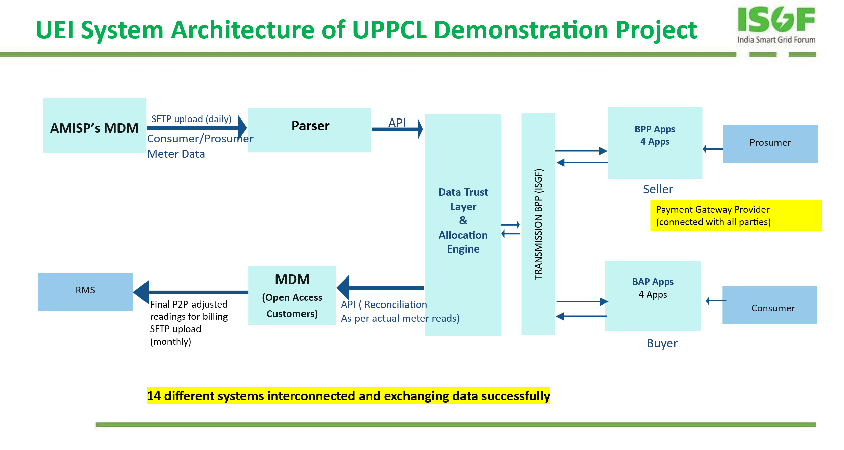
UEI System Architecture of UPPCL Demonstration Project

Slide 11
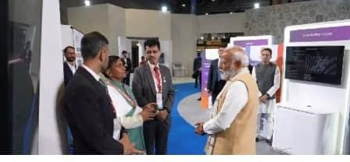
World’s First Interstate P2P Demonstration at Global AI Summit
The India Energy Stack (IES) Strategy 0.2 and IES Architecture 0.2 envisaged to demonstrate the feasibility of interstate P2P trading, and ISGF supported the pilot project in NCR involving following DISCOMs:
PVVNL under UPPCL which supplies electricity in Noida and Ghaziabad area in the NCR where smart meters are deployed under RDSS. PVVNL implemented Oracle MDMS and Billing System.
TPDDL, Delhi: In TPDDL service area in Delhi where Tata Power’s Unified Data Stream (UDS) is the MDMS and SAP ISU Billing System.
BSES Rajdhani Power Ltd (BRPL): The pilot demonstration covered BRPL’s prosumers and consumers with smart meters in Janakpuri area in Delhi.
The Interstate P2P Trade Demo project was showcased by MOP at the Global AI Impact Summit in February 2026, marking the world’s first interstate P2P experiment on a Digital Energy Grid and positioning India as a global leader in this space.

Slide 12

Contact US
reena.suri@indiasmartgrid.org
India Smart Grid Forum
CBIP Building, Malcha Marg, Chanakyapuri, Delhi-110021
www.indiasmartgrid.org
www.isuw.in
www.dumindia.in
Follow us at:
Twitter - @IndiaSmartGridF |Facebook - @IndiaSmartGridF| LinkedIn - India Smart Grid Forum (ISGF)

