Slide 1
Peer 2 Peer Energy Trading
Presentation By
Tarun Batra, Head-D&IT, TPDDL
S.M. Abidi, AGM-RCM, TPDDL

Slide 2
Framework of Peer to Peer (P2P) Energy Trading Program
Trigger
Regulatory Mandate – DERC Guidelines 2024 & 2025 National alignment with Indian Energy Stack (IES) Ministry of Power (MoP) vision for interstate P2P. Accelerating distributed renewable adoption
End to End Digital Life Cycle
Registration → Trading → Settlement → Billing
Regulatory & Compliance Framework
Eligibility validation as per DERC Guidelines
Secure Digital Integration
Secure API integration with P2P platform
Trading & Billing Integration
P2P trading integrated with billing schema
Registration
- Registration through CA no. & registered Mobile no.
- Smart meter must for Consumer & Prosumer.
Eligibility
- Sanction load < 200KW.
- Capacity for RES < 500% of Sanction load.
- Group Net metering / Virtual Net metering prosumers not eligible.
Trading
- Restricted to 20% of installed Capacity.
- Transaction Price: Mutually agreed between Prosumer & Consumer.

Slide 3
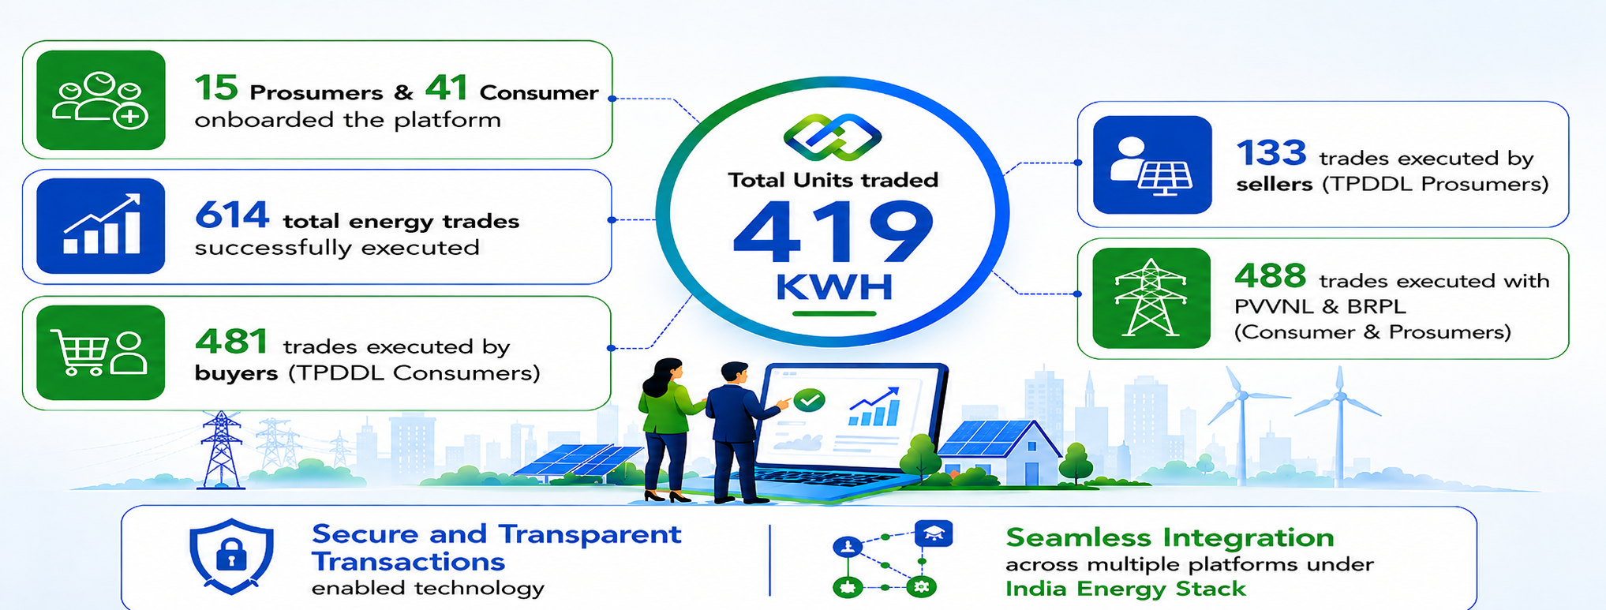
Peer 2 Peer Energy Trading Platform
Energy Trading enabled through 11 TSP
Consumers & Prosumers of TPDDL / BRPL / PVVNL onboarded on P2P platforms.
Successful trade has been started for inter DISCOM & interstate.

Slide 4
Summary Peer 2 Peer Trades
TPDDL P2P Buyer Trades
Seller DISCOM | No. of trades | Energy Units (KWH) Settled
BRPL | 34 | 3
PVVNL | 384 | 357
TPDDL | 63 | 29
Total | 481 | 389
TPDDL P2P Seller Trades
Buyer DISCOM | No. of trades | Energy Units (KWH) Settled
BRPL | 70 | 1
TPDDL | 63 | 29
Total | 133 | 30
Meter | Rate Category
11045174 | E-DOMESTIC
75155085 | E-DOMESTIC
79000450 | E-VEHICLE
79002064 | E-VEHICLE
79010637 | E-VEHICLE
79021936 | E-VEHICLE
79023360 | E-NDLT
79036295 | E-VEHICLE
79038033 | E-VEHICLE
79038482 | E-VEHICLE
79041891 | E-VEHICLE
79044791 | E-VEHICLE

Slide 5
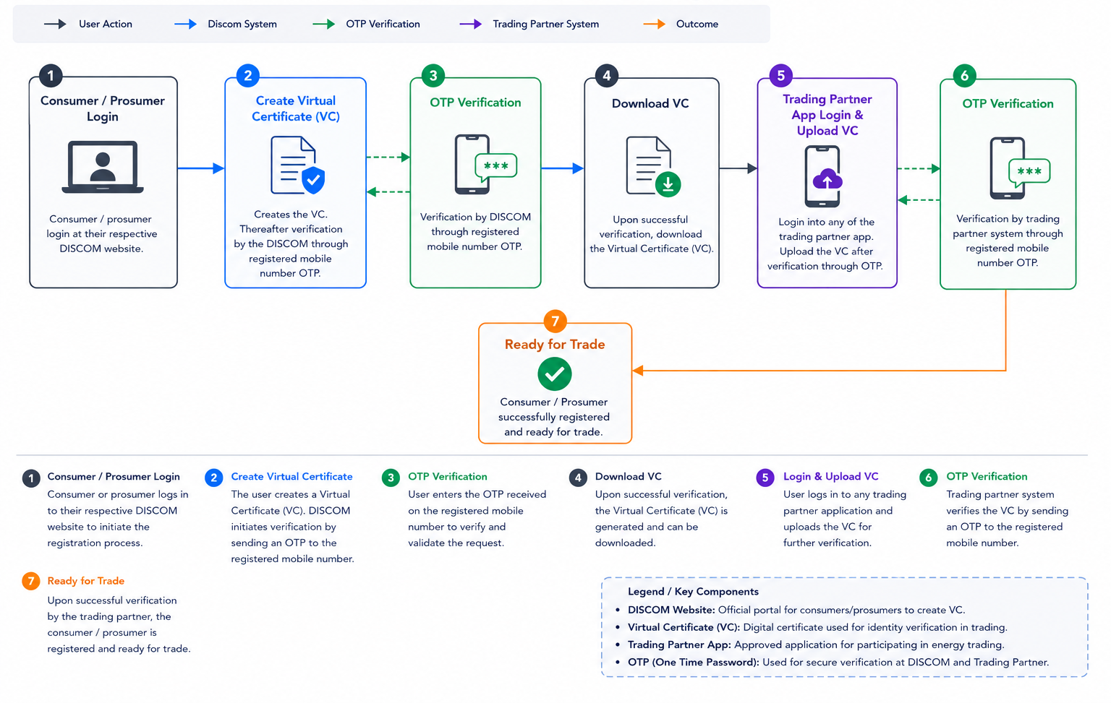
Peer 2 Peer Consumer / Prosumer Registration

Slide 6
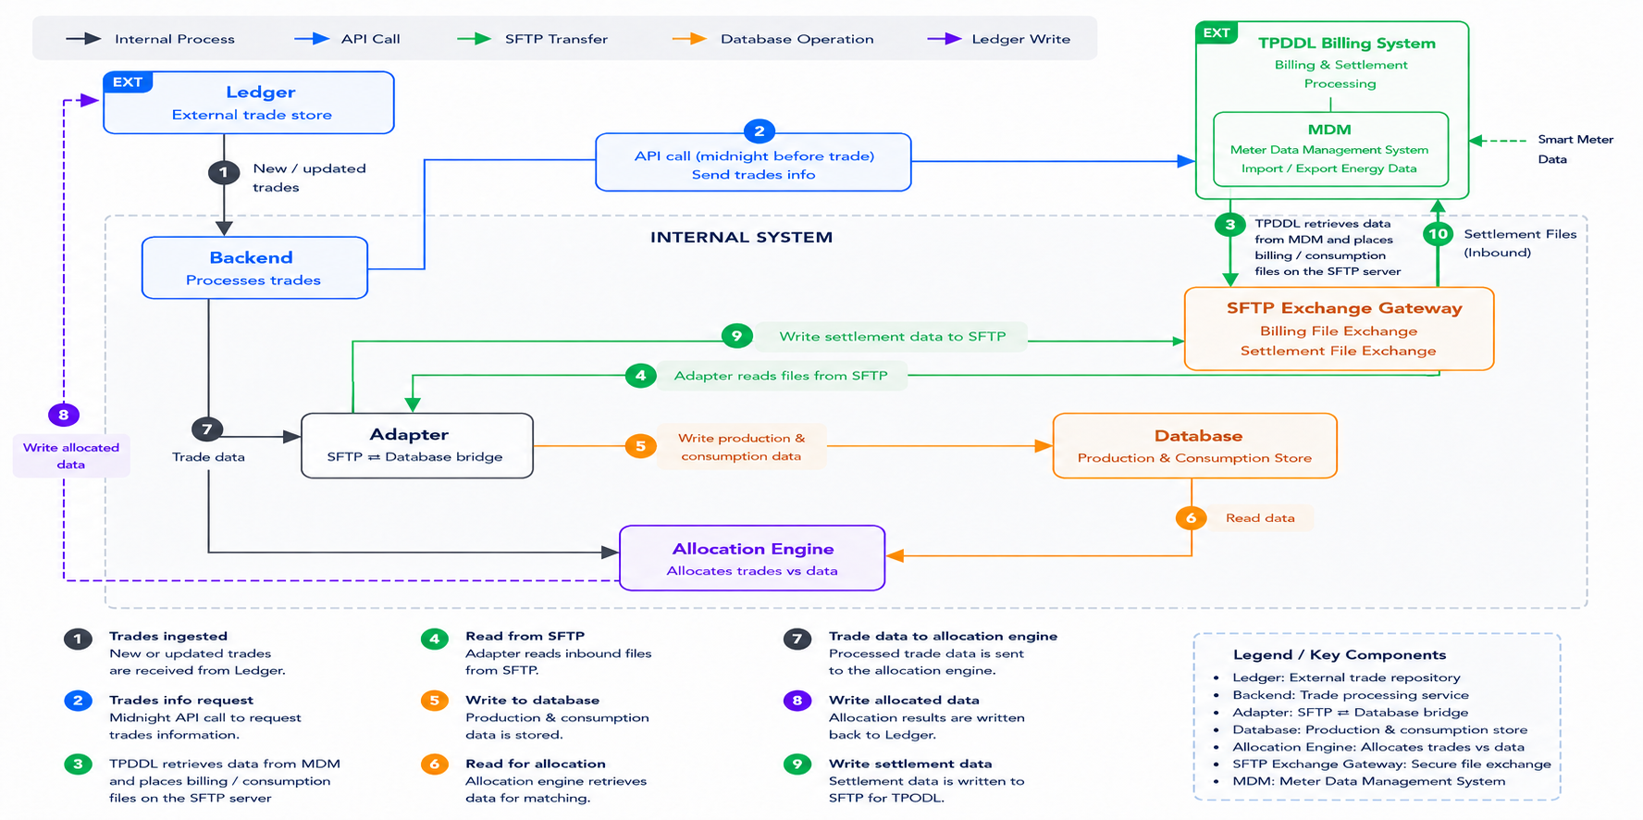
Peer 2 Peer trading - Process flow

Slide 7
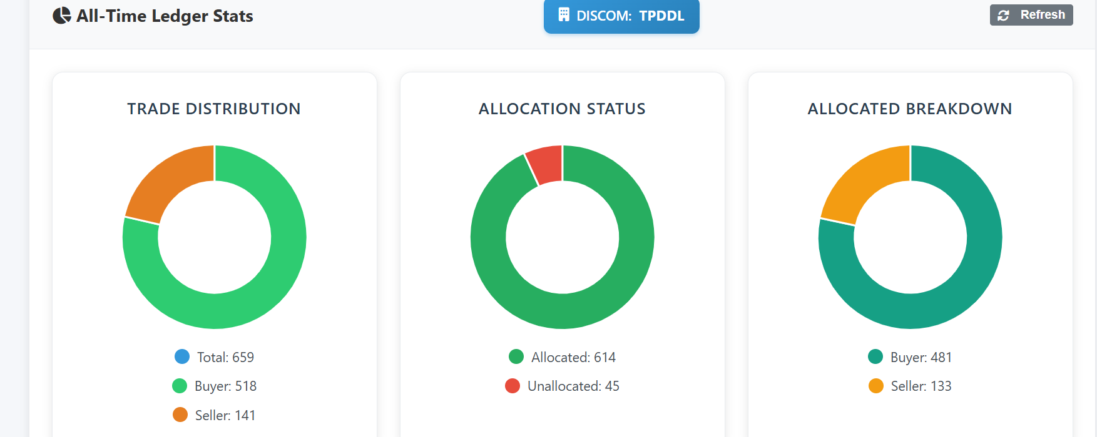
Peer 2 Peer Dash Board

Slide 8
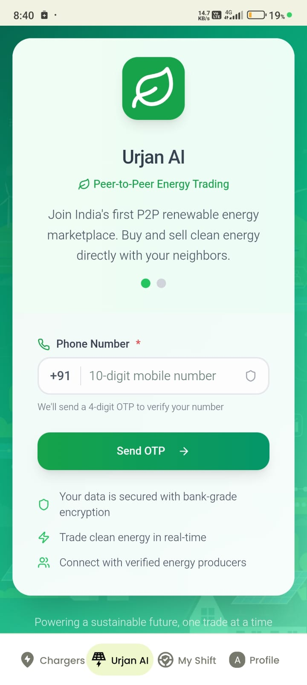
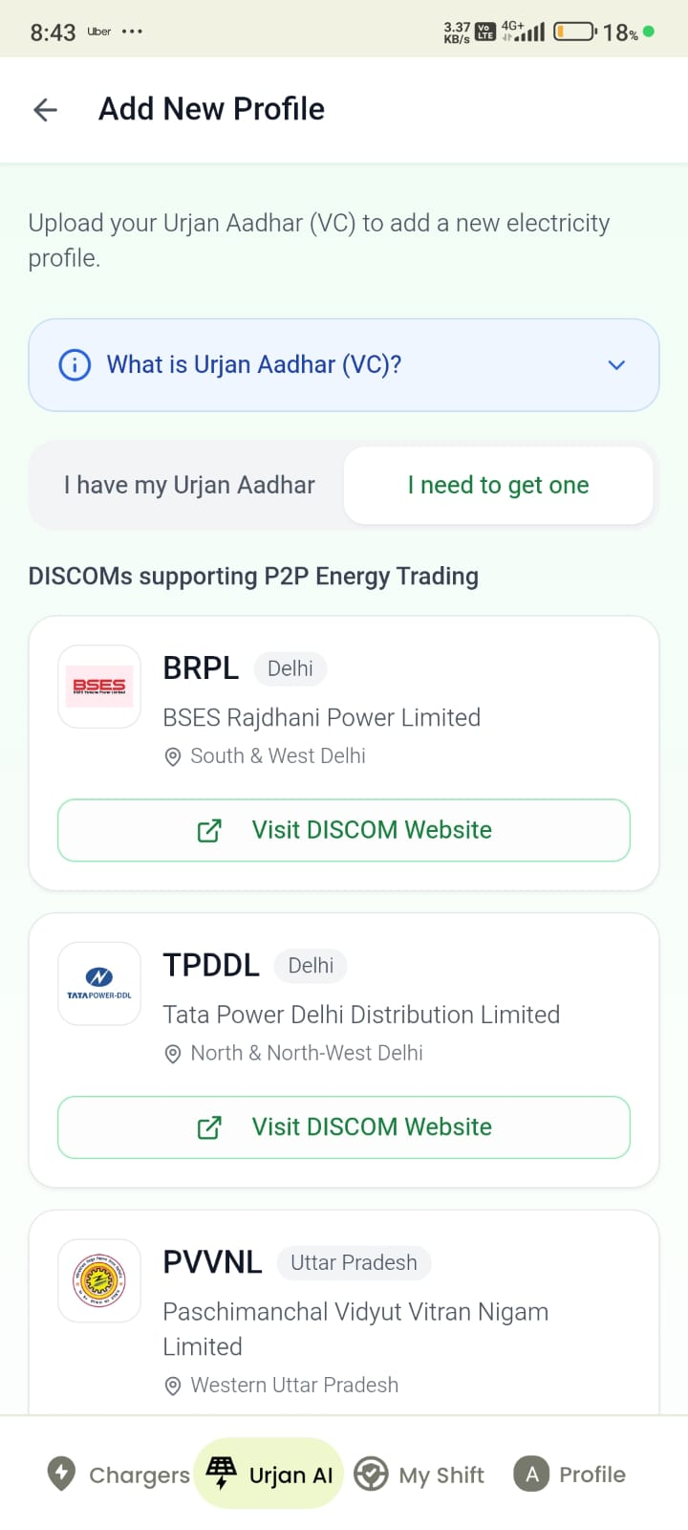
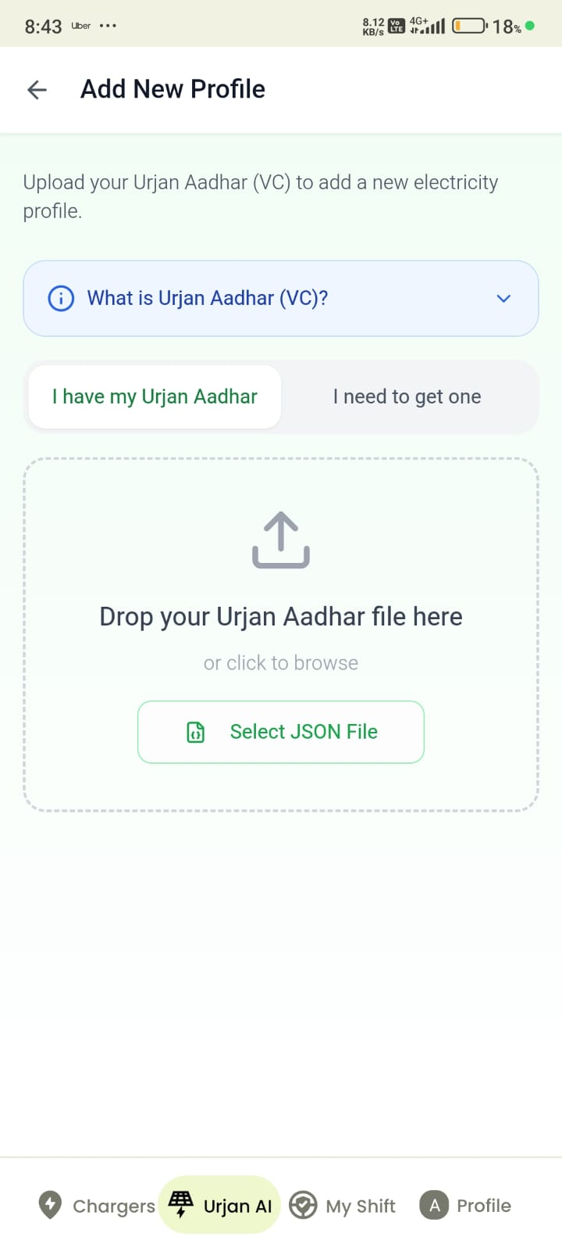
Registration platform for Consumer & Prosumer

Slide 9
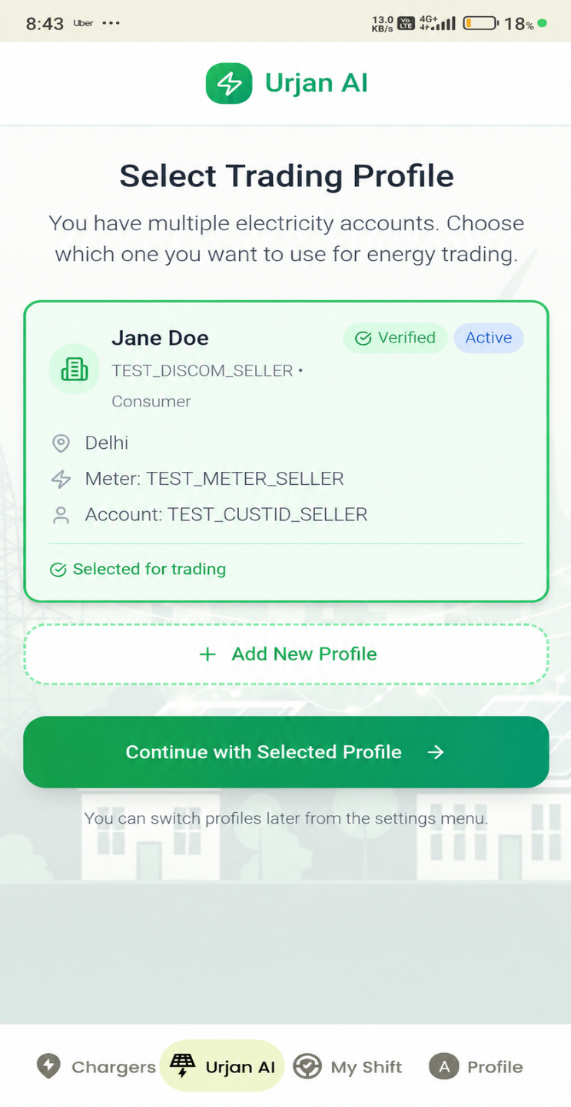
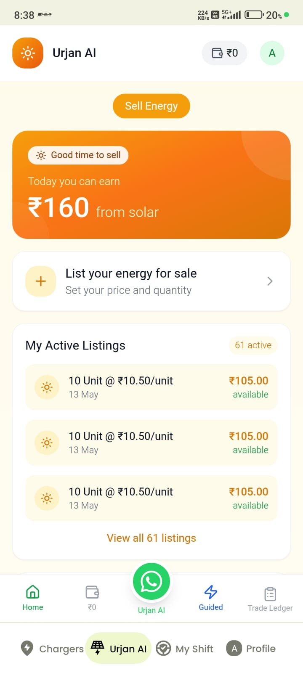
Registered as Prosumer

Slide 10
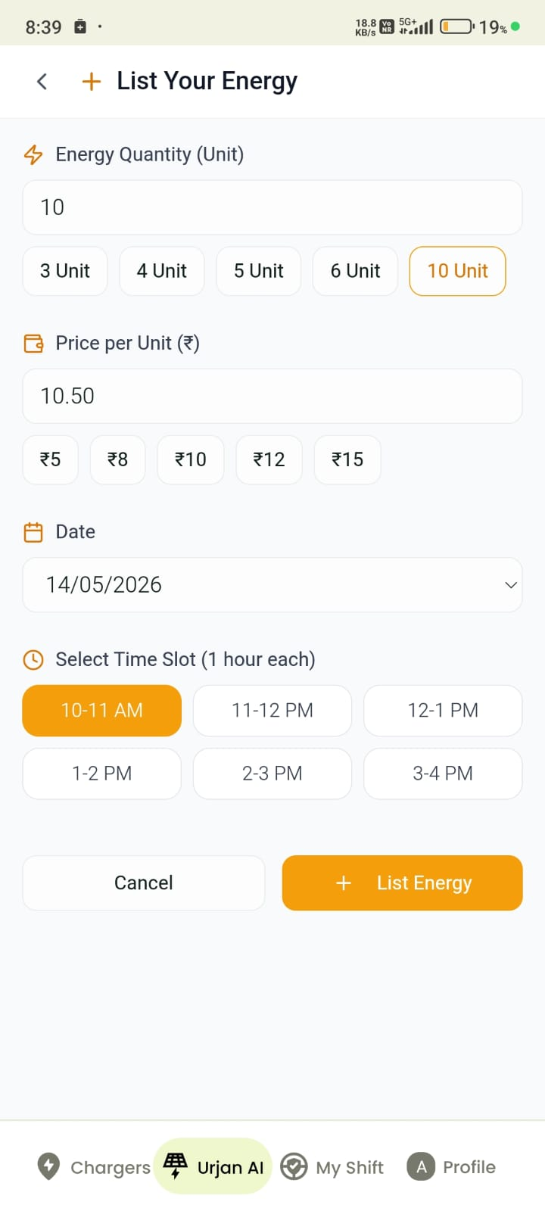
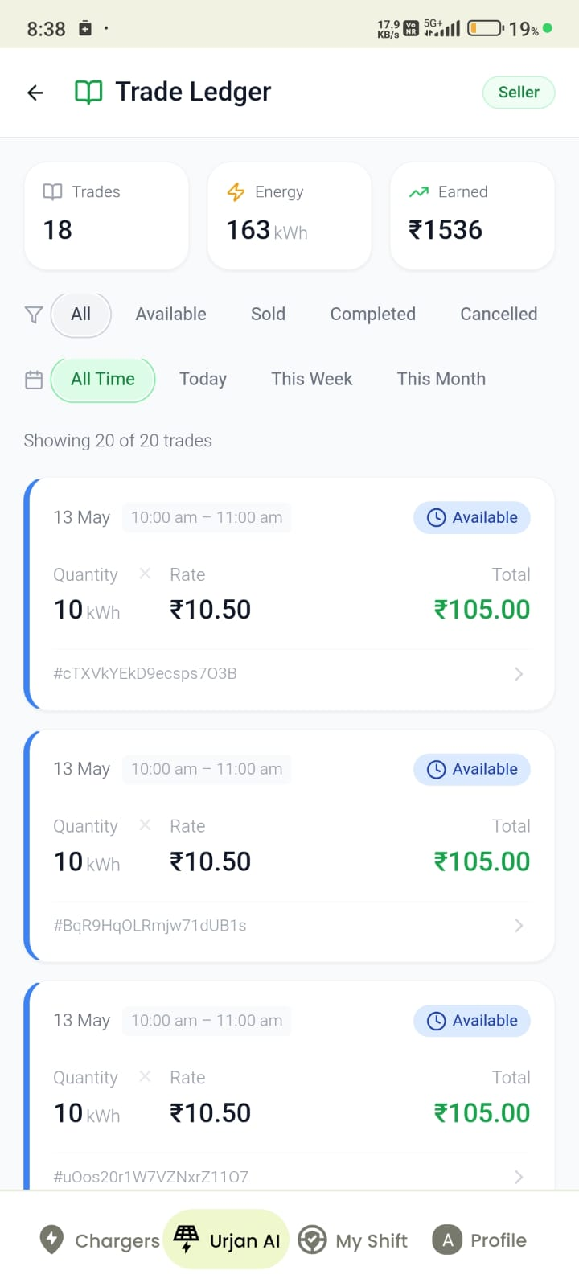
Listing of Energy for sale and trade ledger

Slide 11
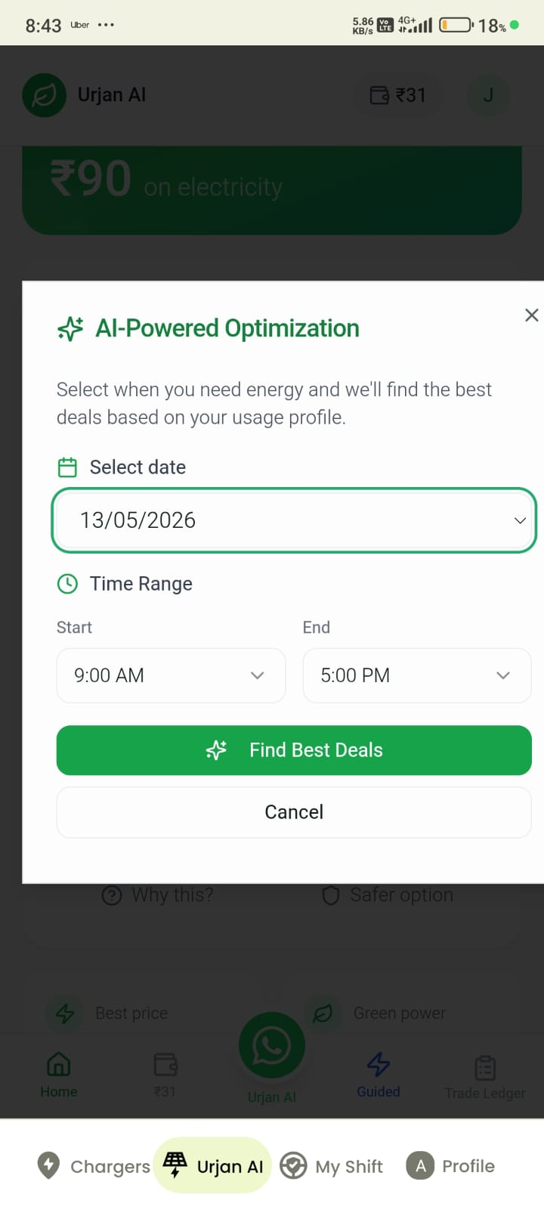
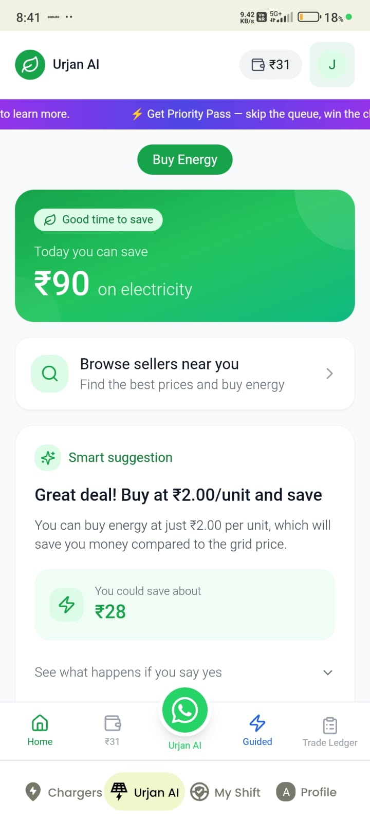
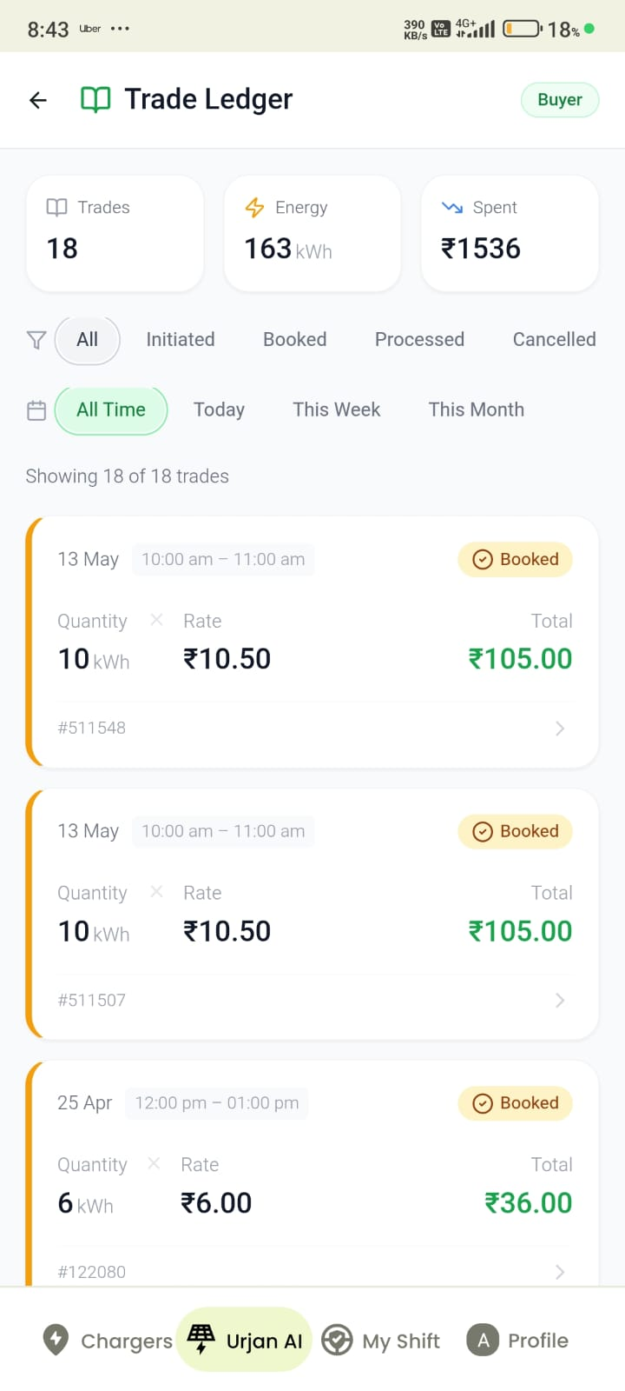
Registered as Consumer & Purchase of Energy

Slide 12
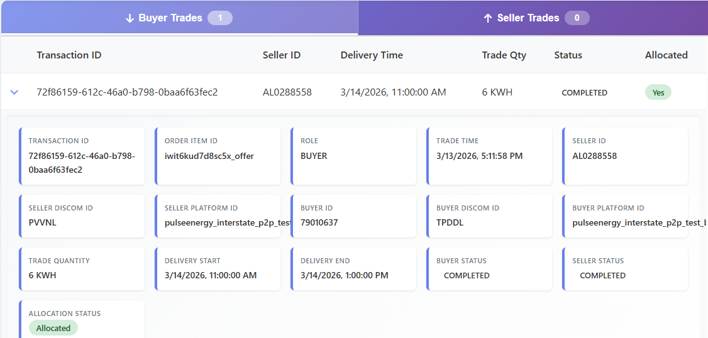
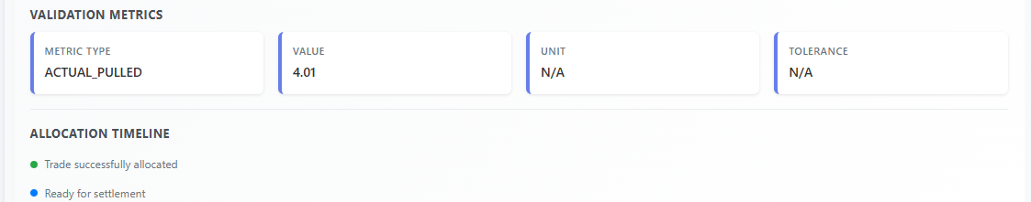
Peer 2 Peer trade - Interstate
Notes:
Where is ready for settlement? We need to show the ready to settlement.

Slide 13
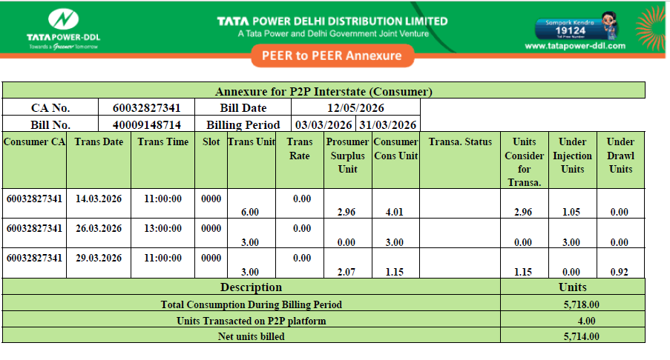
P2P Sample Billing Annexure
Total Consumption During the billing period – 5718 units
Units Traded on P2P Platform – 4 units
Net Units billed – 5714 units

Slide 14
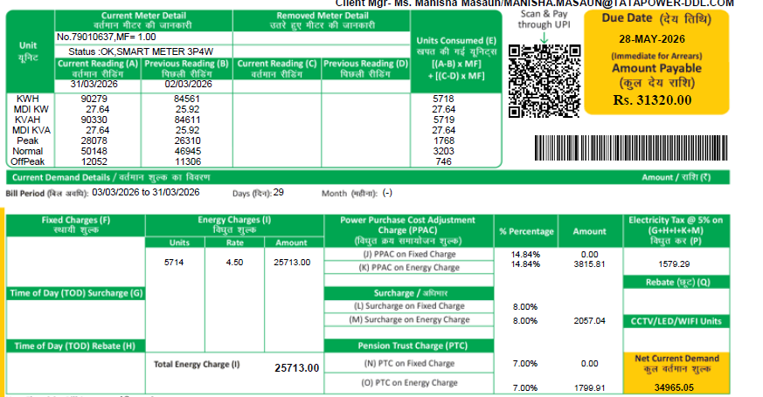
P2P Sample Billing Annexure
Units Billed - 5714

Slide 15
Challenges as we Scale
Wheeling Charges is to be decided for inter state. (At present, not decided by DERC)
Cross Subsidy Surcharges
Platform upkeep cost is high as compared to recover through transaction charges
No action on Under Injection and under Drawl
Allocation logic shall be centralized.

