Slide 1


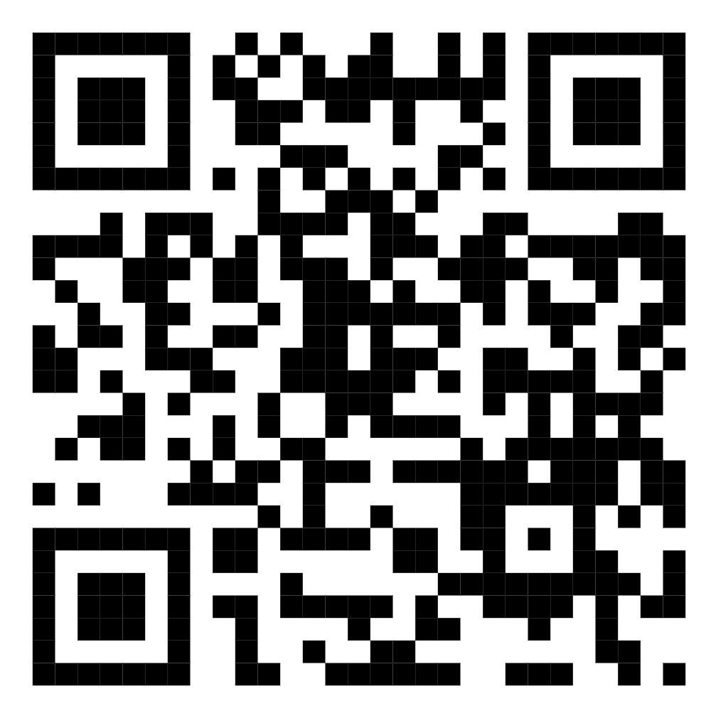
Welcome
Stakeholder Workshop Organized by
All India Discoms Association | Prayas (Energy Group)
STRENGTHENING LOAD RESEARCH
AND DEMAND FORECASTING IN DISCOMs
Towards Robust Planning for India's Evolving Electricity Demand
Please scan and provide your responses to a short questionnaire on Load Forecasting and Data Availability

