Slide 1



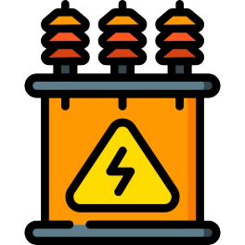



Power Portfolio Management : Tripura
Tripura State Electricity Corporation Ltd.
(A Govt. of Tripura Enterprise)
24.06.2026

Slide 2
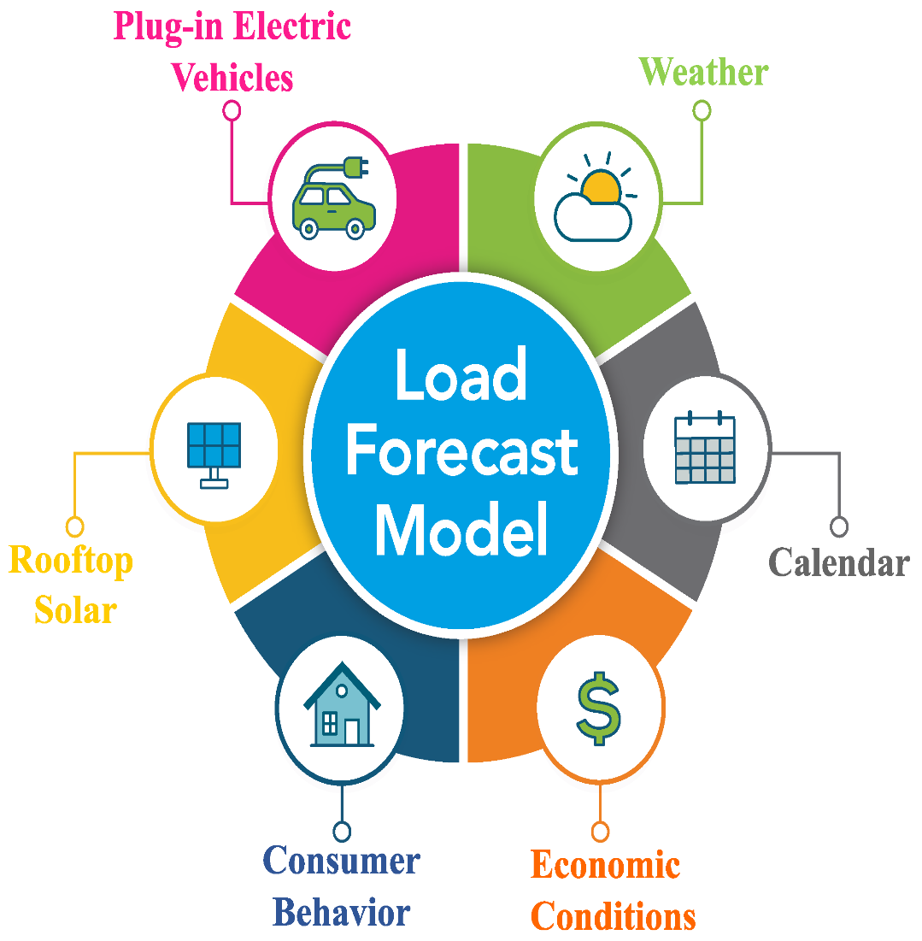
Presentation Flow
Present Power Scenario
Load Forecasting & Demand Projection
Resource Adequacy Plan

Slide 3
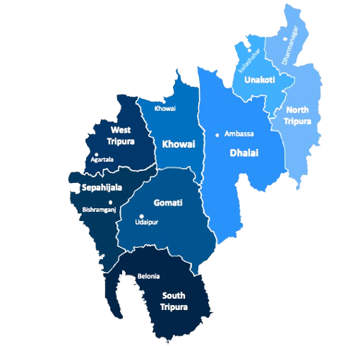
Tripura Power Scenario (Present): Supply & Demand
Peak Demand : 542 MW
Total Availability: 410 MW
Intra-State Genr: 100 MW
Allocation from ISGS: 310 MW
Power Market: 132 MW
Solar Capacity: 103 MW
  Roof Top Solar: 53 MW
  Solar ISGS: 50 MW
Energy requirement: 1900 MU/Yr

Slide 4
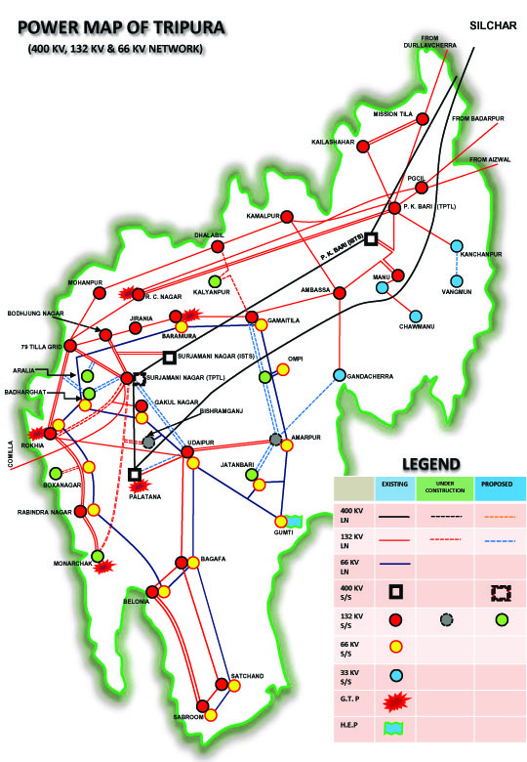
Tripura Power Scenario (Present): Transmission
132 KV Line: 987 Ckm
66 KV Line: 360 Ckm
132 KV Sub-station: 1522 MVA (21 nos.)
Transmission availability: 97%
Transmission Reliability: 2.5 trippings/line

Slide 5
Tripura Power Scenario (Present): Distribution
Distribution Line
    33 KV: 1086 ckm
    11kV : 20,540 ckm
    LT : 34,857 ckm
Substation
  33/11kV : 86 Nos. (775 MVA)
  DT: 21,724 Nos. (1,616 MVA)
Consumers: 10,64,258 Nos.
Domestic Consumer : 88%
HT : 3.5%
AT&C Losses: 18.23% as on 31.03.2026

Slide 6
Tripura Seasonal Load Curve
3 Seasons Load Curve

Slide 7
Monthly Peak Demand - Supply Scenario
SHORT-FALL
TOTAL I/C CROSS-BORDER
STATE DEMAND
SURPLUS POWER
ISGS
OWN GENERATION

Slide 8
Load Research
3 Seasons Load Curve
Key Parameters Monitored Daily
  Entitlement for ISGS share → Allocation from central generating stations
  Previous day drawal → Actual vs scheduled consumption
  Bangladesh drawal → Cross‑border exchange tracking
  State generation → Output from state plants
  Shutdown of state line & impact → Transmission outages and reliability effects
  System Stability & Market Signals
  Frequency pattern → Monitoring deviations around 50 Hz
  RTM activities → Real‑time market trades for balancing demand
  DSM pattern → Settlement of deviations from schedule

Slide 9
Daily Load Research and Demand Projection-Practice
3 Seasons Load Curve
Assimilate historical load data from SCADA/SLDC for last 3 years.
Collection of 33kV substation wise past loading profile.
Analysis of previous day demand pattern (96 blocks) and corresponding day demand of the last 3 years.
Review of weather conditions and forecast.
Energy Efficiency measures & Demand Side Management

Slide 10
Daily Load Research and Demand Projection-Practice
3 Seasons Load Curve
Consideration of weekday, weekends, holiday and special events.
Assessment of expected State and renewable generation (Rooftop Solar).
Transmission constraint both inter and intra-state system.
Estimation of peak demand and daily energy requirement.
Preparation of Day-Ahead Forecast for scheduling and market participation.

Slide 11
Balancing Mechanism
3 Seasons Load Curve
  Demand–Supply Balancing Methodology
  Weather report → Rainfall/temperature forecasts impacting demand & hydro inflows
  Load forecast → Anticipated demand for upcoming hours/days
  Backdown of generation → Curtailments due to surplus or constraints
  URS power → Un-requisition surplus available for scheduling of any generating station.
  Surrender of power → Relinquished share due to low demand or cheaper alternatives.

Slide 12
Power Portfolio Management
3 Seasons Load Curve
Start
Load Forecast & Weather Assessment
Resource Assessment
Demand–Supply Gap Analysis
DAM Participation
Day-Ahead Scheduling
Real-Time Monitoring
RTM Participation
DSM Management
Minimize Deviation Charges
Assess Available Power Resources
(ISGS + State Generation + RE + URS)
Assess Backdown
/ Surrender Opportunity
Surplus Power?
Power Deficit?
Yes
Yes
Participate in DAM
for Day-Ahead Requirement
Demand / Generation Deviation
Yes
NO
Post-Operation Performance Review
(DAM, RTM, DSM, Cost Optimization Analysis)
END

Slide 13
Long-term Demand Projection
Year | Particulars | April | May | June | July | August | Sept | Oct | Nov | Dec | Jan | Feb | March
2025-26 | State Peak Demand (actual) | 334.30 | 347.10 | 336.09 | 374.47 | 362.00 | 376.91 | 346.89 | 310.09 | 240.35 | 237.20 | 246.47 | 289.30
2026-27 | State Peak Demand (Projection) | 344.33 | 351.20 | 365.90 | 385.70 | 372.86 | 388.22 | 357.30 | 319.39 | 247.56 | 244.32 | 253.86 | 297.98
2027-28 | State Peak Demand (Projection) | 354.66 | 361.74 | 376.88 | 397.28 | 384.05 | 399.86 | 368.02 | 328.97 | 254.99 | 251.65 | 261.48 | 306.92
2028-29 | State Peak Demand (Projection) | 365.30 | 372.59 | 388.18 | 409.19 | 395.57 | 411.86 | 379.06 | 338.84 | 262.64 | 259.19 | 269.32 | 316.13

Slide 14
Resource Adequacy Plan

Slide 15
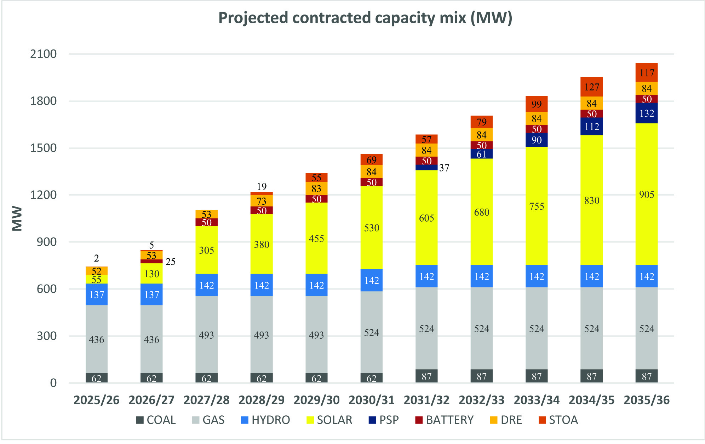
Resource Adequacy Plan …contd

Slide 16
Resource Adequacy Plan …contd

Slide 17

Summary
Load Research & Demand Projection enabling power supply reliability
  Supply challenges due to increased penetration of Renewable capacity
  Continuous improvement in technique/process
  Optimisation of Power Portfolio Cost
  Capacity building

Slide 18

Thank You
director.technical@tsecl.in

